Slide 1
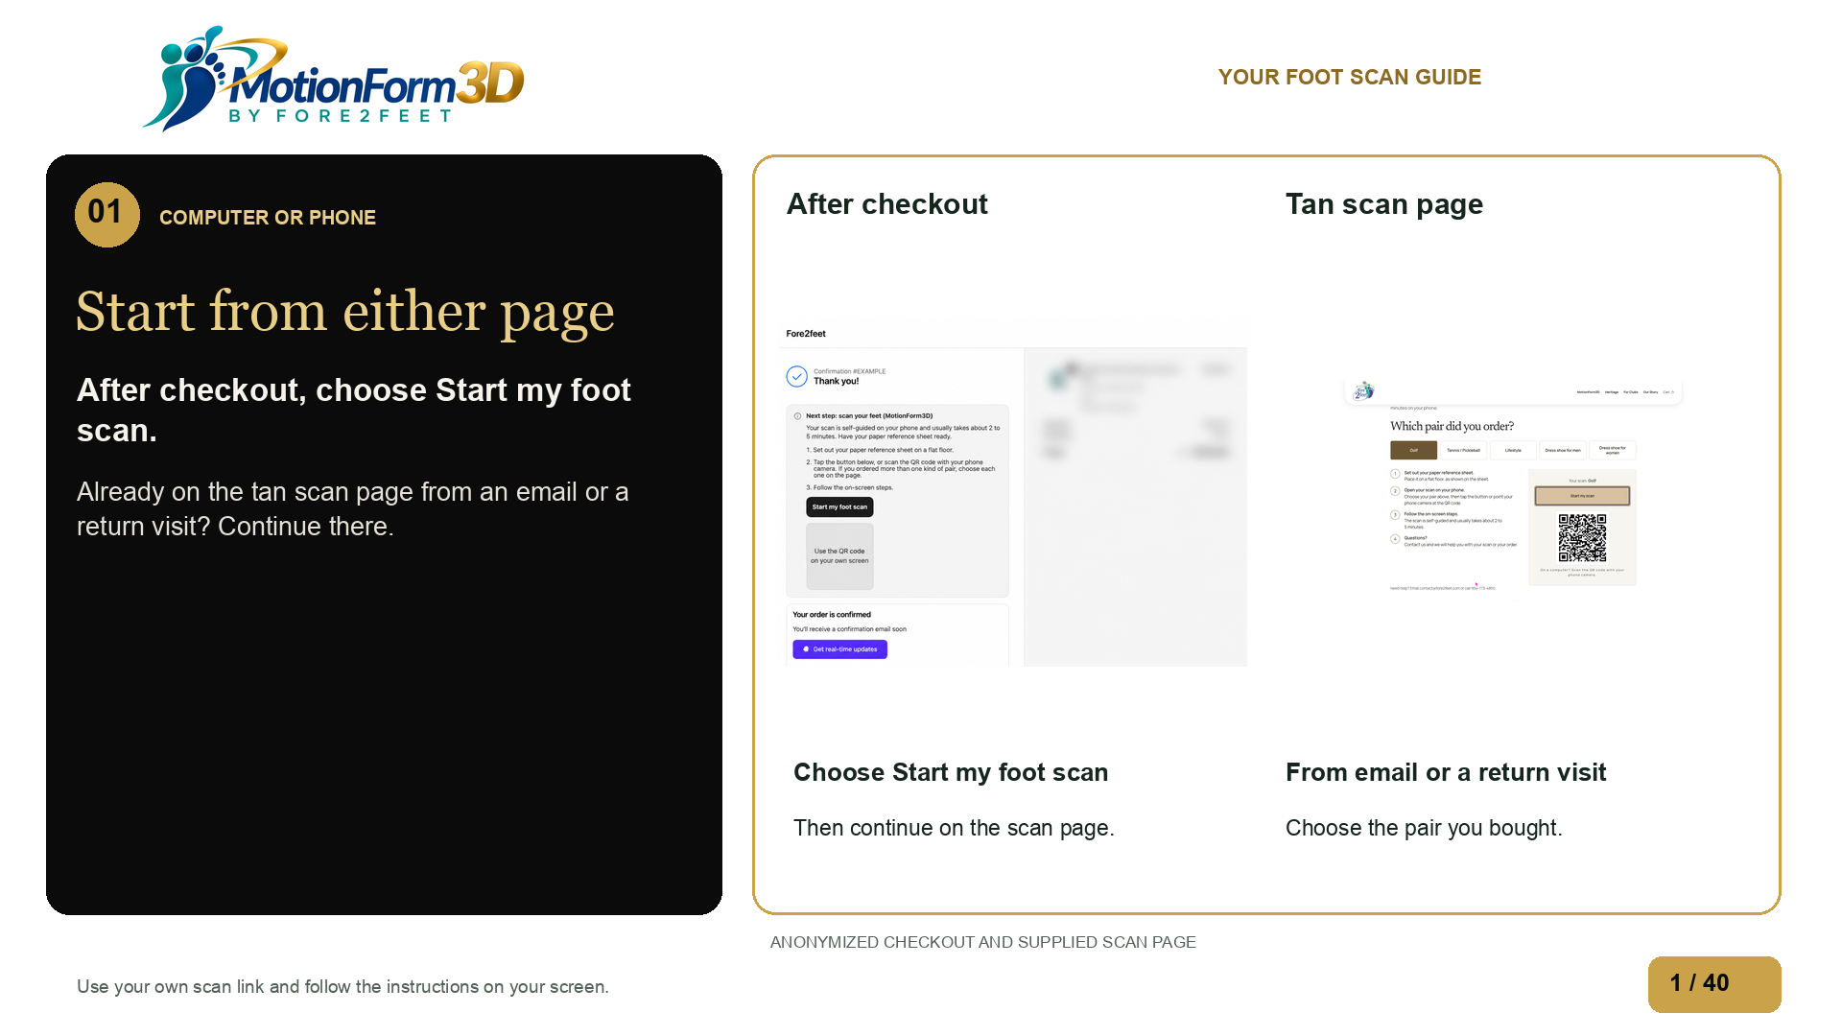
Notes:
After buying MotionForm3D, you may be on this order confirmation page or the tan foot scan page. You may have opened the scan page from an email or returned to it later. On the order confirmation page, choose Start my foot scan. If you are already on the tan scan page, continue there. We will use Golf as the example. You can start on a computer or phone, but you will need your phone for the photos.
Source: edited-images/checkout-anonymized.png

Slide 2
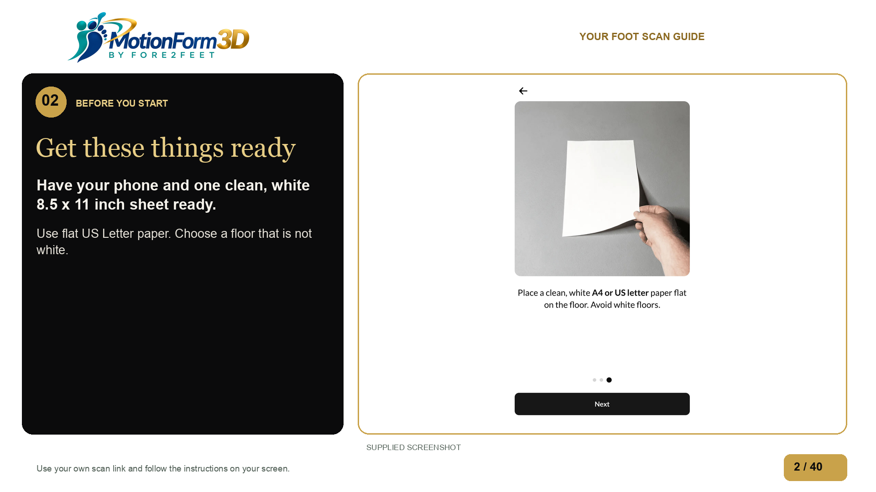
Notes:
Get your phone and one clean sheet of white paper. Use standard US Letter paper, eight and a half by eleven inches. Lay it flat on a floor that is not white. Keep your computer nearby if you start there.
Source: supplied-images/IMG_0165-1792034645778-b1il24.jpg

Slide 3
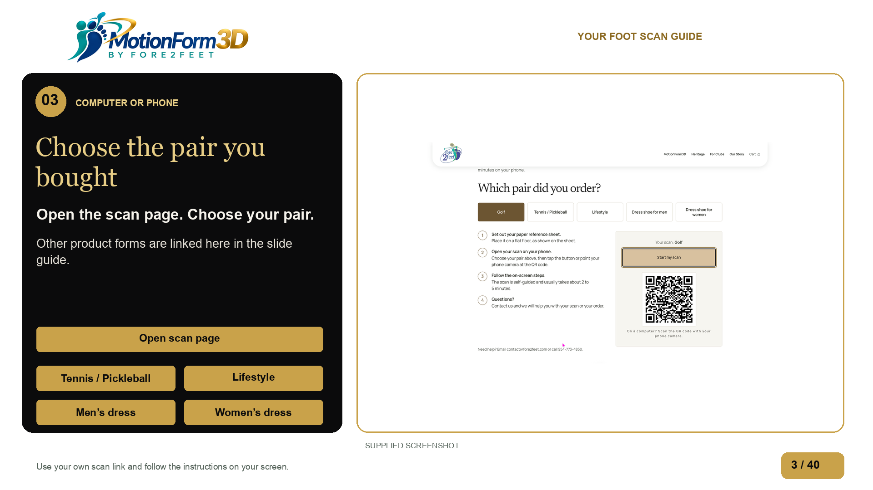
Notes:
On the tan scan page, choose the type of pair you bought. The button and QR code change with your choice. This video follows Golf. The slide guide has the other product forms beside this step. After your form, continue with the shared scan instructions.
Source: ../scan-entry-product-and-qr.png

Slide 4
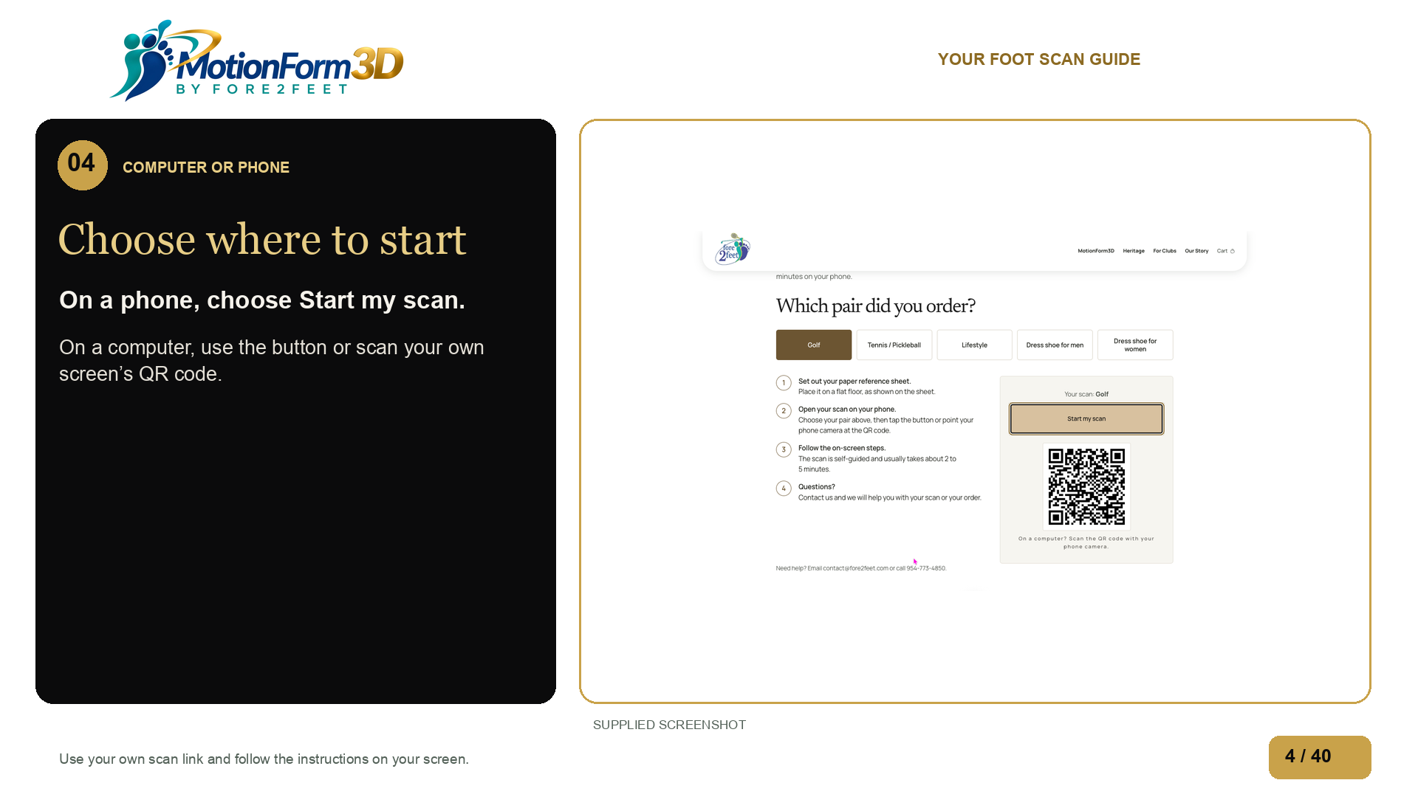
Notes:
On your phone, choose Start my scan. On a computer, you can choose the same button to fill out the form there. Or use your phone camera to scan the code on your own computer screen, then open the link. That puts the form on your phone.
Source: ../scan-entry-product-and-qr.png

Slide 5
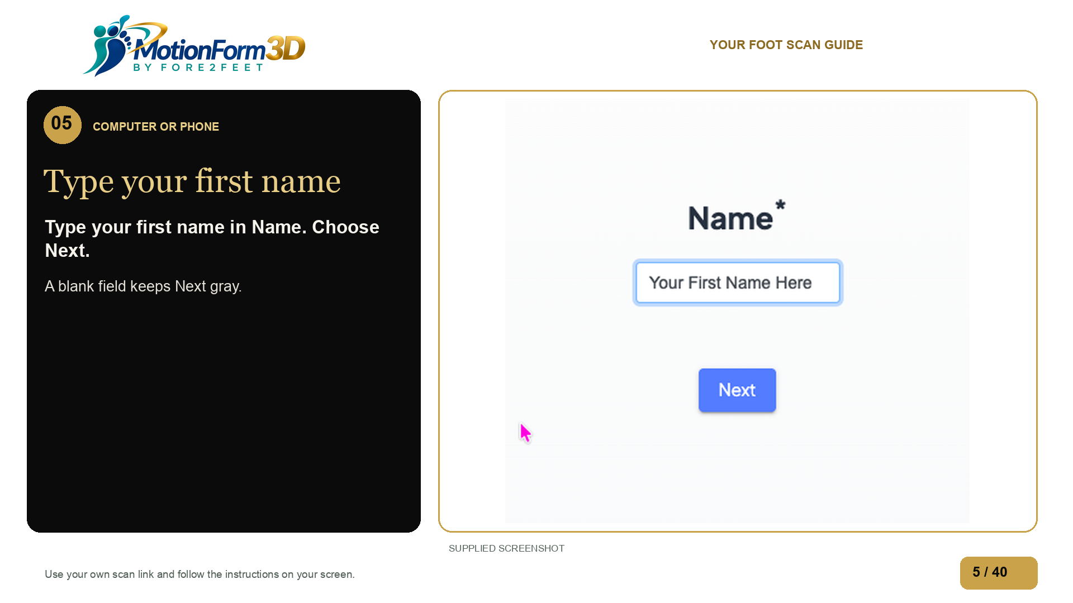
Notes:
Enter your first name, then choose Next. Use your own details throughout the form. If Next is gray, fill in the box first.
Source: ../questionnaire-first-name-filled.png

Slide 6
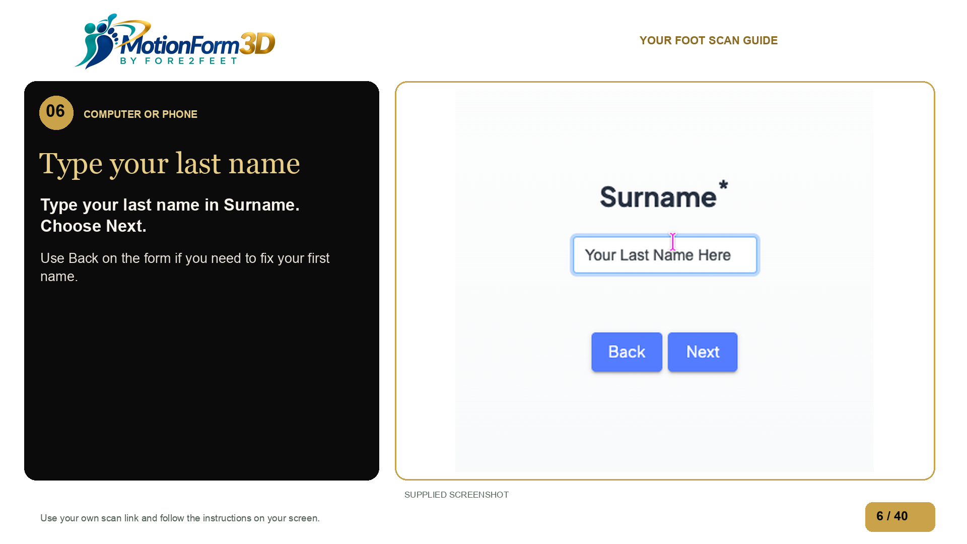
Notes:
Surname means last name. Enter your last name, then choose Next. To fix an earlier answer, use Back on the form.
Source: ../questionnaire-surname.png

Slide 7
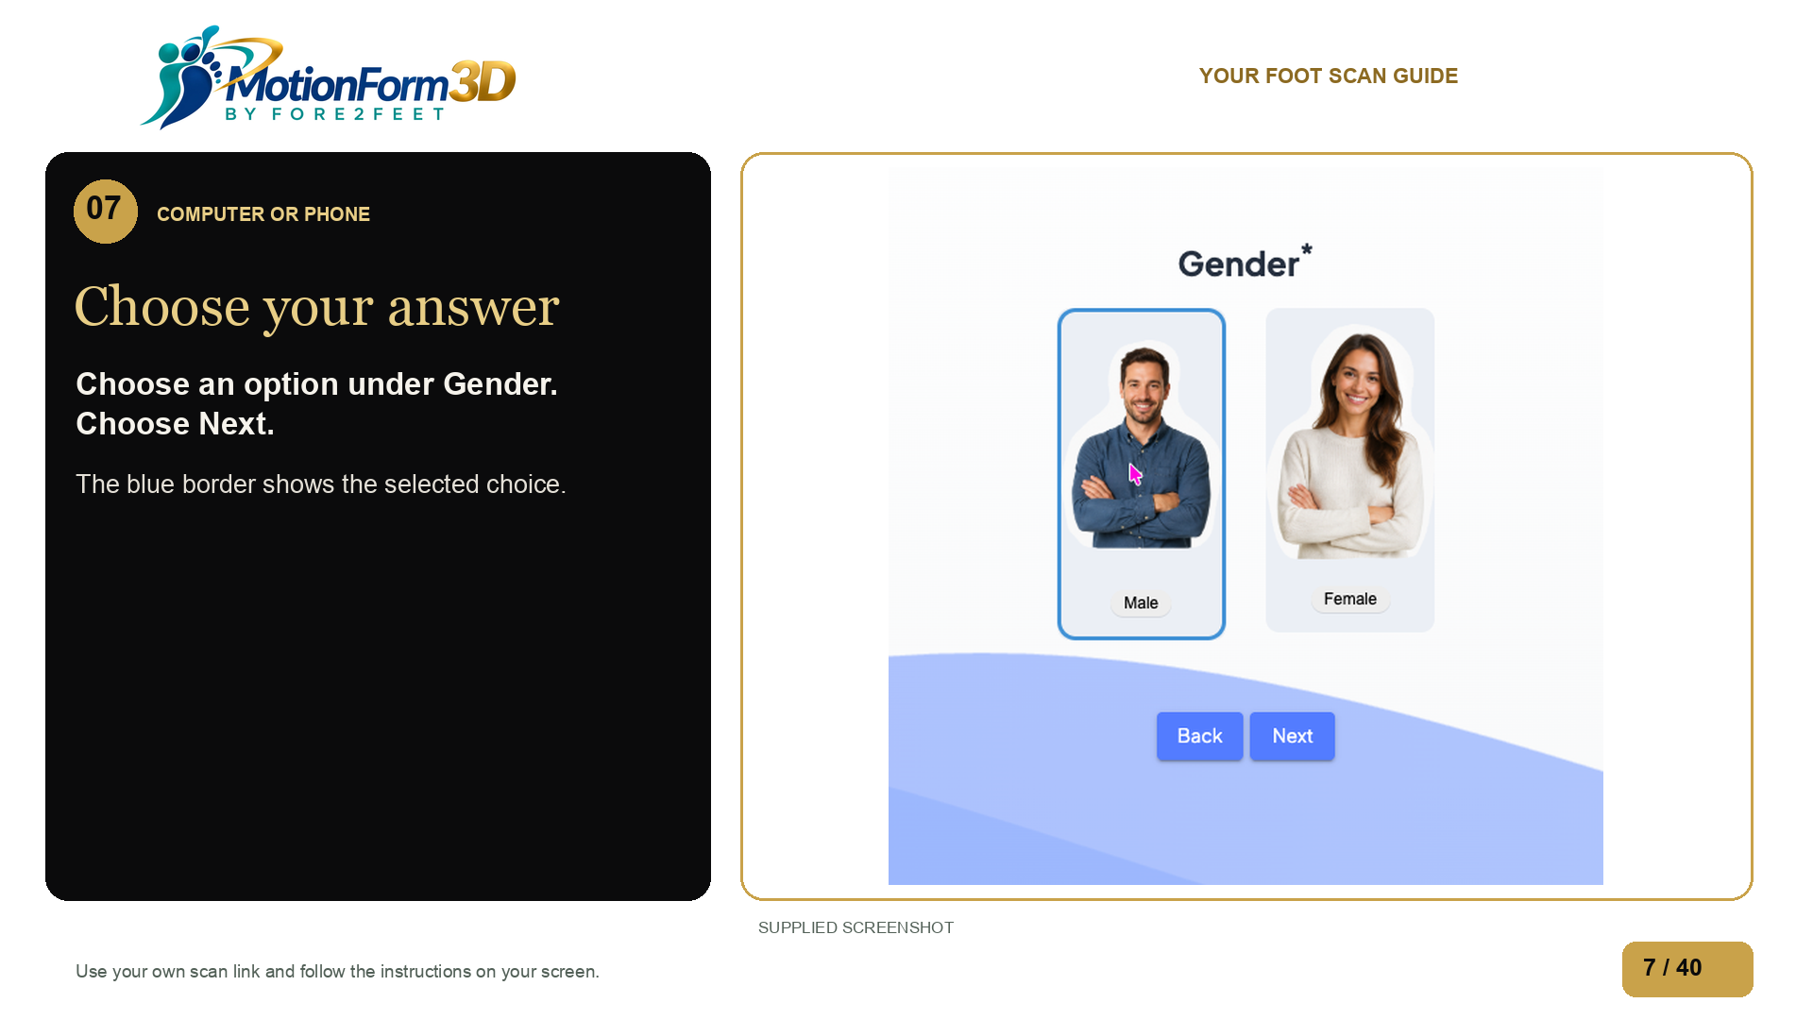
Notes:
Choose an option under Gender. The blue border shows your selection. Then choose Next.
Source: ../questionnaire-gender-selected.png

Slide 8
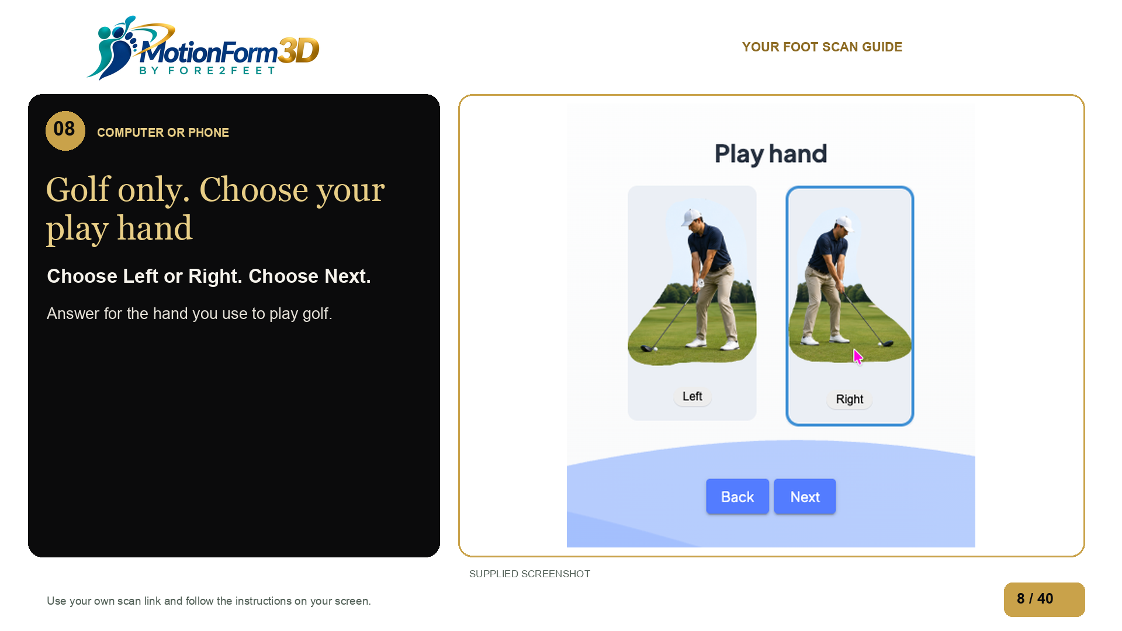
Notes:
For Golf, choose Left or Right for your golf playing hand. Then choose Next.
Source: ../questionnaire-golf-play-hand.png

Slide 9
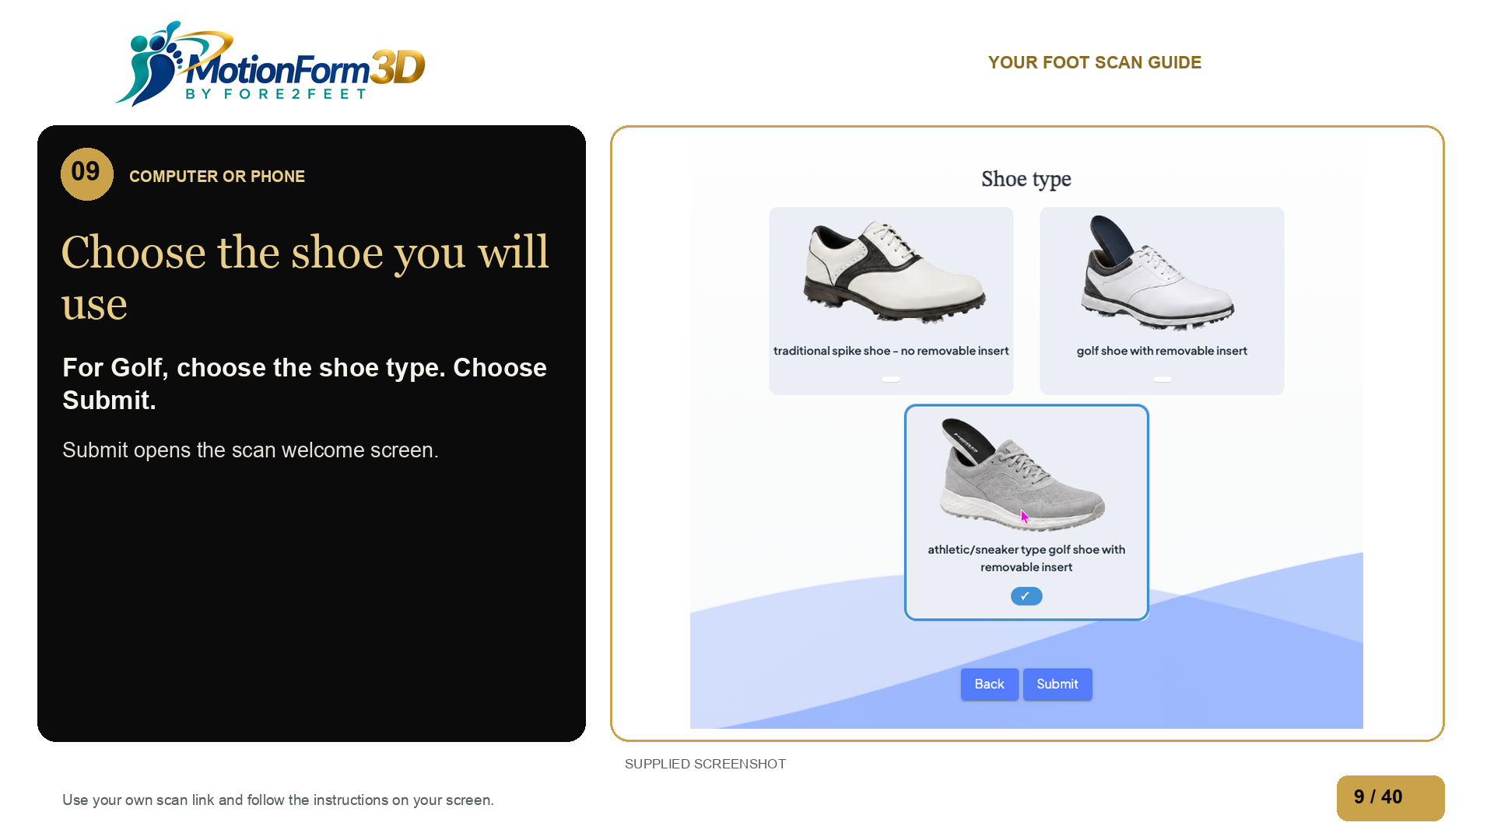
Notes:
Choose the type of shoe you will use with your pair. Read the shoe labels, make your choice, then choose Submit to open the scanner.
Source: ../questionnaire-golf-shoe-type.png

Slide 10
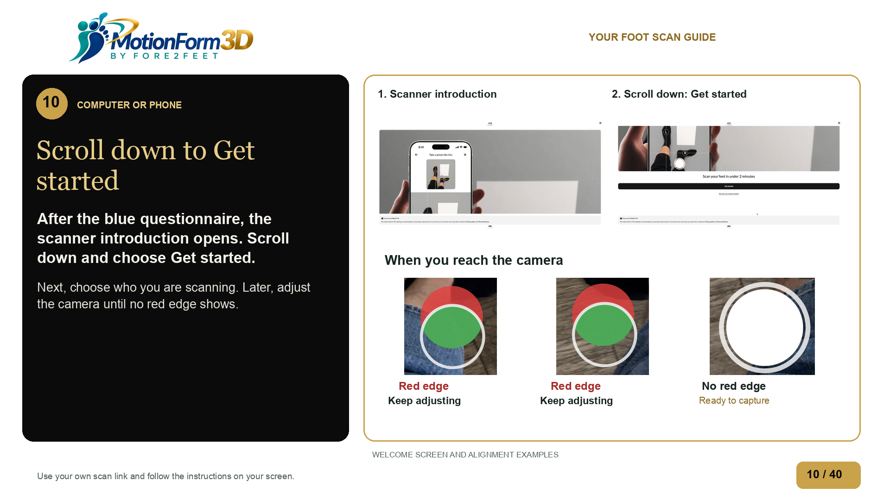
Notes:
When you finish the blue Wikyapps questionnaire, this scanner introduction opens. Scroll down to the Get started button and select it. Next you will choose who you are scanning. When you reach the camera, move or tilt slowly until the circles line up with no red edge showing.
Source: ../scan-introduction-get-started.png

Slide 11
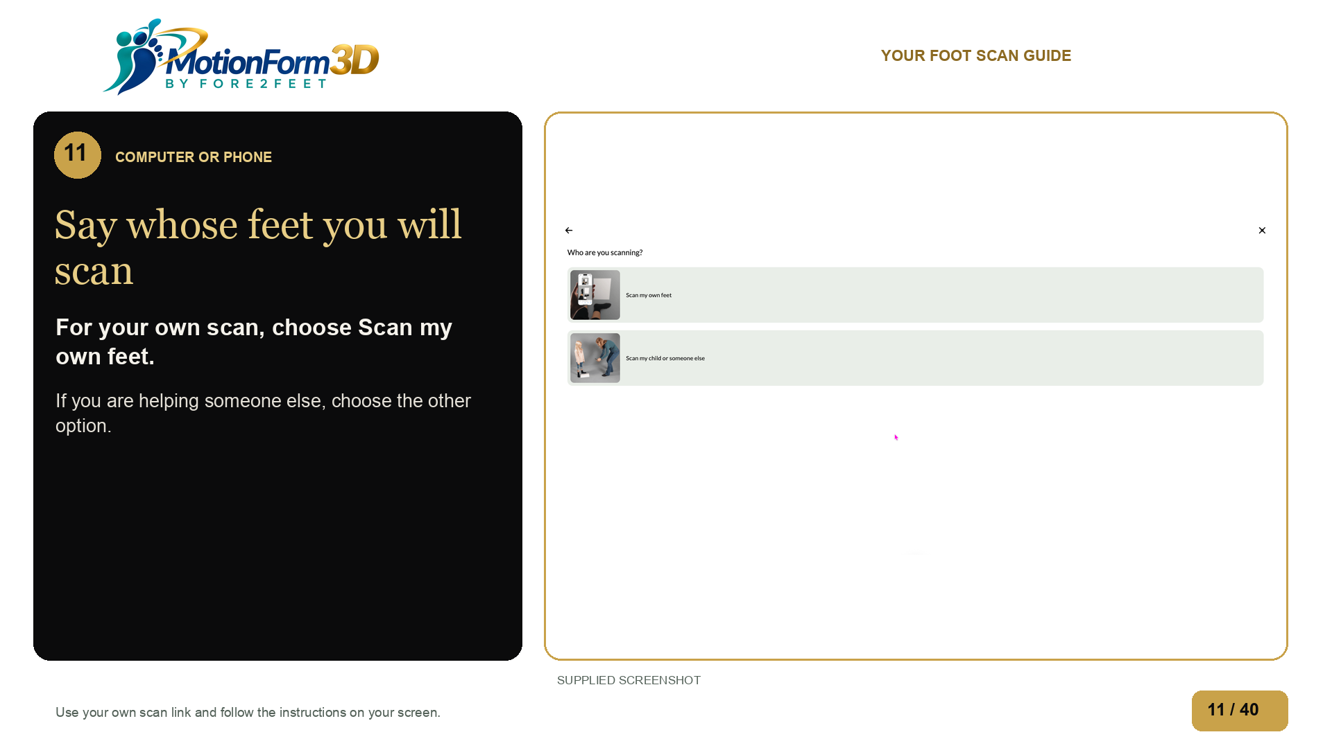
Notes:
For your own scan, choose Scan my own feet. If you are scanning a child or someone else, choose that option. This example follows your own feet.
Source: ../scan-who-are-you-scanning.png

Slide 12
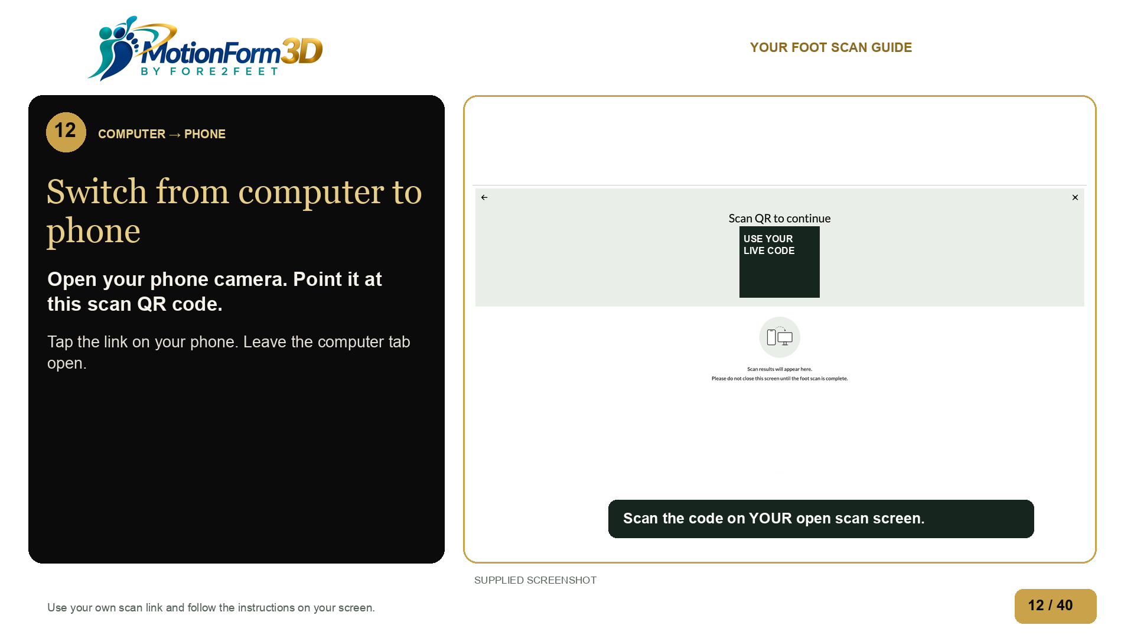
Notes:
If you started on a computer, a new QR code appears here. Use your phone camera to scan the code on your own computer screen. Open the link and leave that computer tab open. If you started on your phone, stay on your phone.
Source: supplied-images/ScreenShot1014-2321-1792034501308-hz9zee.png

Slide 13
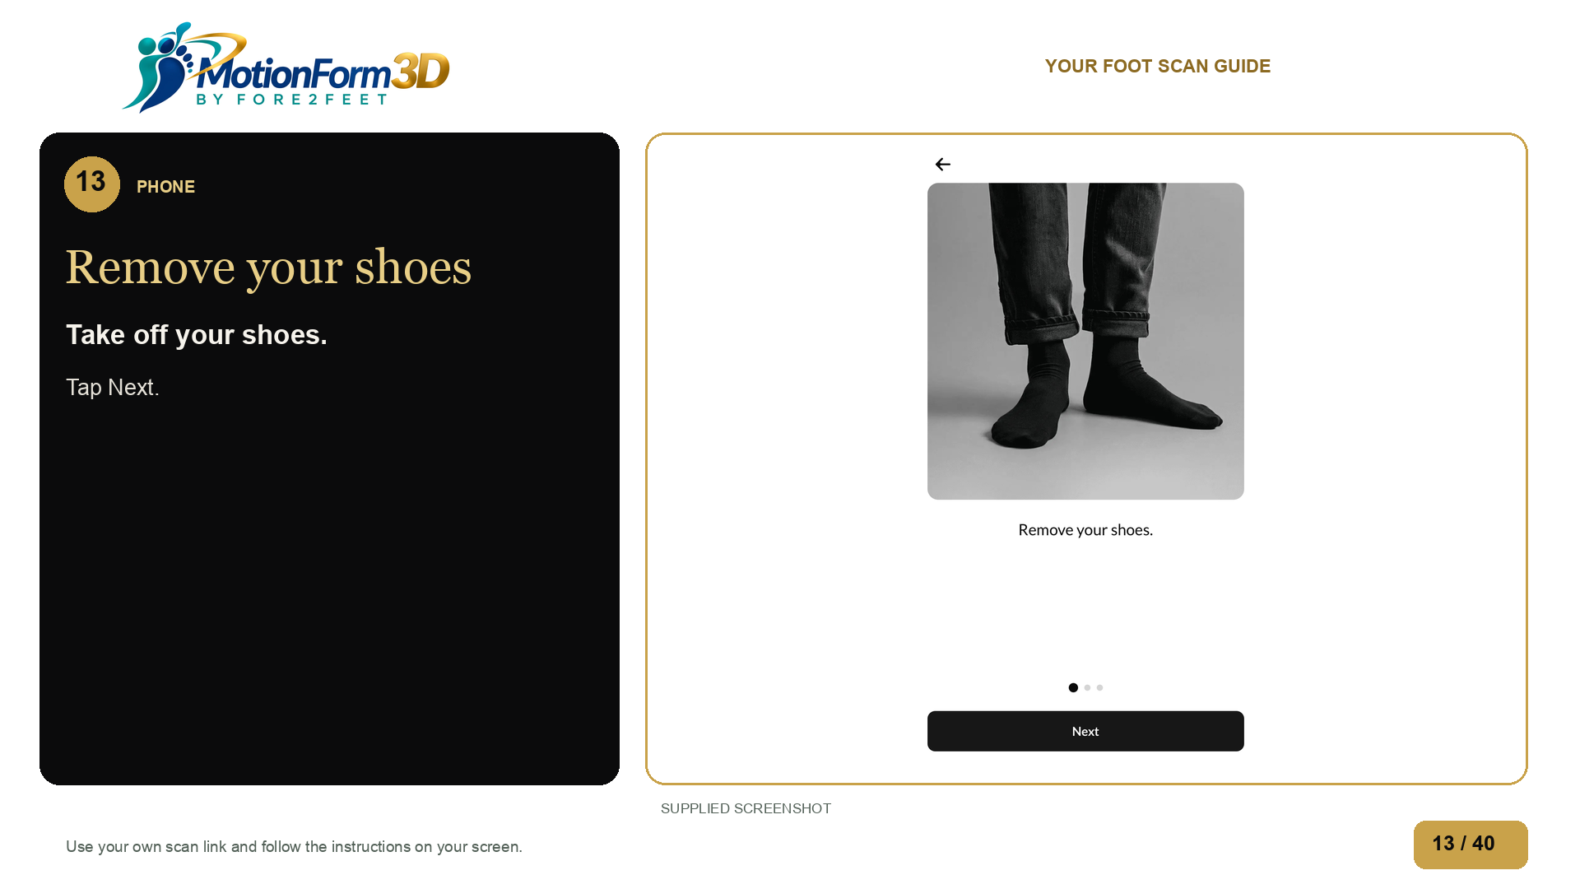
Notes:
Take off your shoes. Tap Next.
Source: supplied-images/IMG_0163-1792034645662-xiznl7.jpg

Slide 14
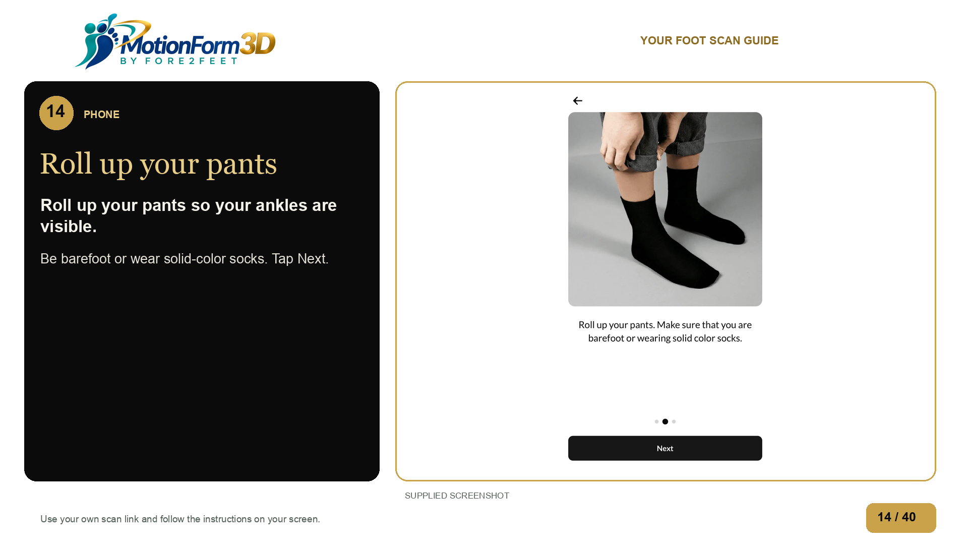
Notes:
Roll up your pants so your ankles are visible. Be barefoot or wear solid-color socks. Tap Next.
Source: supplied-images/IMG_0164-1792034645746-sa8mjo.jpg

Slide 15
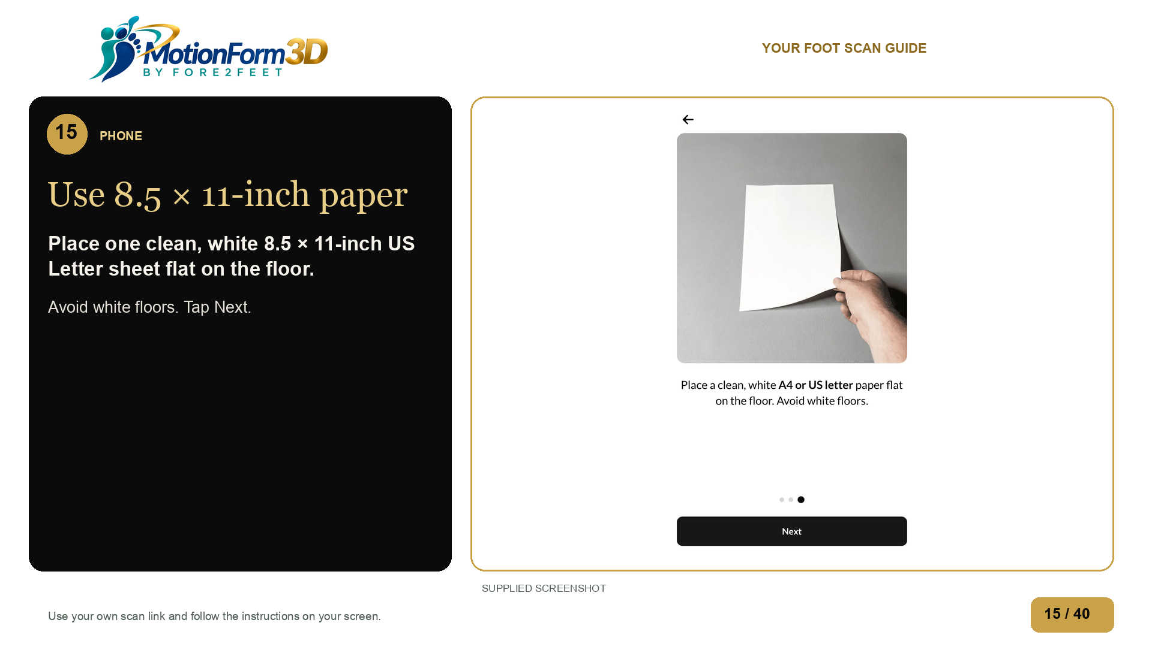
Notes:
Place one clean, white 8.5 × 11-inch US Letter sheet flat on the floor. Avoid white floors. Tap Next.
Source: supplied-images/IMG_0165-1792034645778-b1il24.jpg

Slide 16
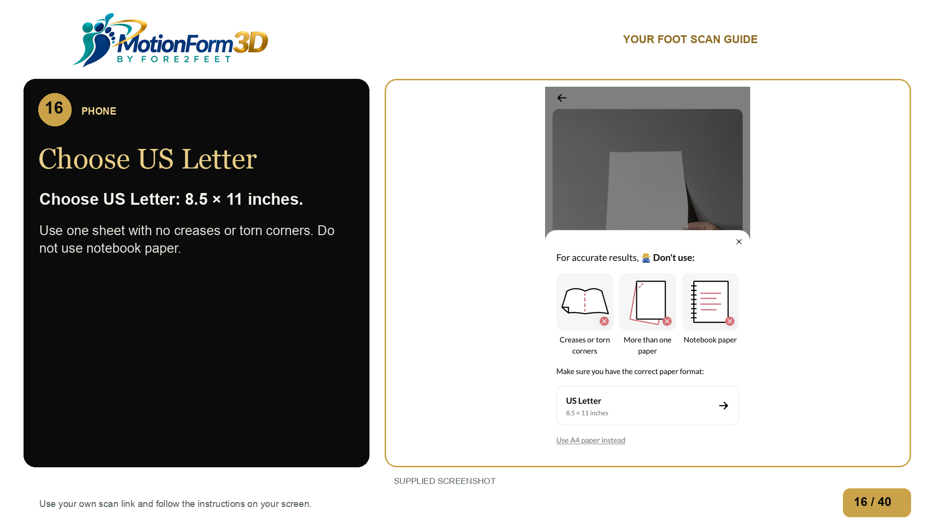
Notes:
Choose US Letter: 8.5 × 11 inches. Use one sheet with no creases or torn corners. Do not use notebook paper.
Source: supplied-images/IMG_0166-1792034645791-v74ej5.jpg

Slide 17
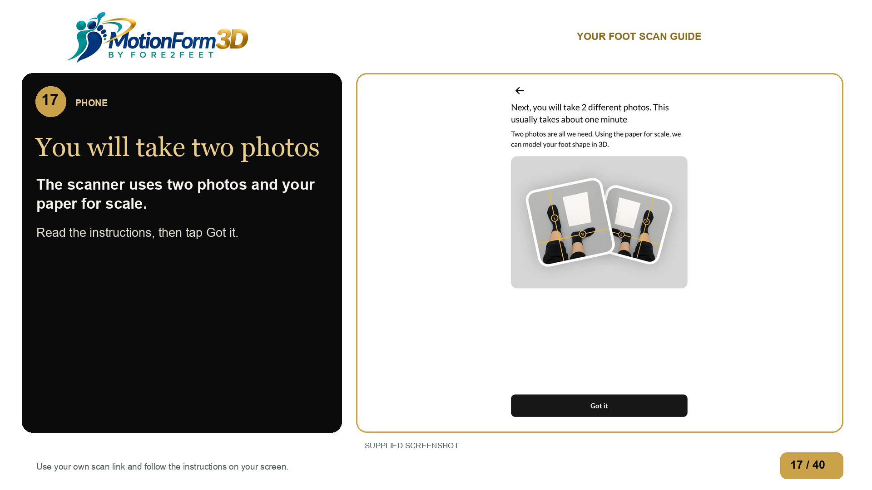
Notes:
The scanner uses two photos and your paper for scale. Read the instructions, then tap Got it.
Source: supplied-images/IMG_0167-1792034645802-jz8q4l.jpg

Slide 18
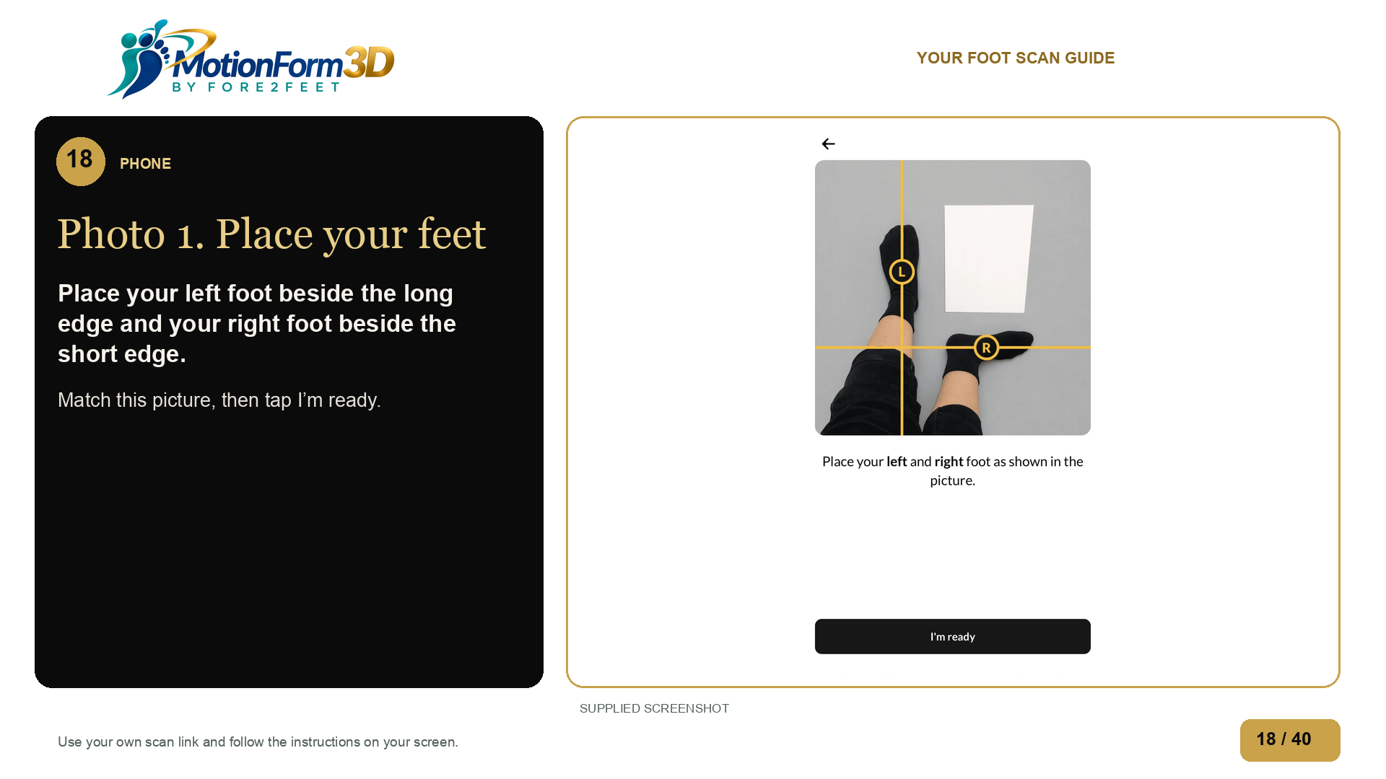
Notes:
Place your left foot beside the long edge and your right foot beside the short edge. Match this picture, then tap I’m ready.
Source: supplied-images/IMG_0168-1792034645813-ie8d3f.jpg

Slide 19
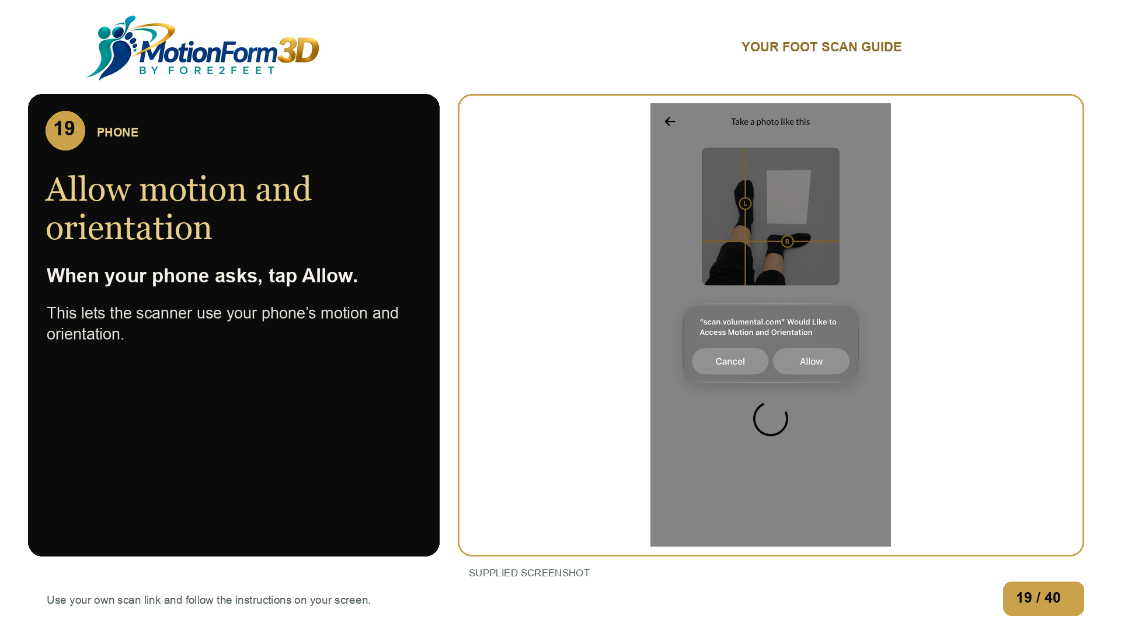
Notes:
When your phone asks, tap Allow. This lets the scanner use your phone’s motion and orientation.
Source: supplied-images/IMG_0169-1792034645825-5sy2wu.jpg

Slide 20
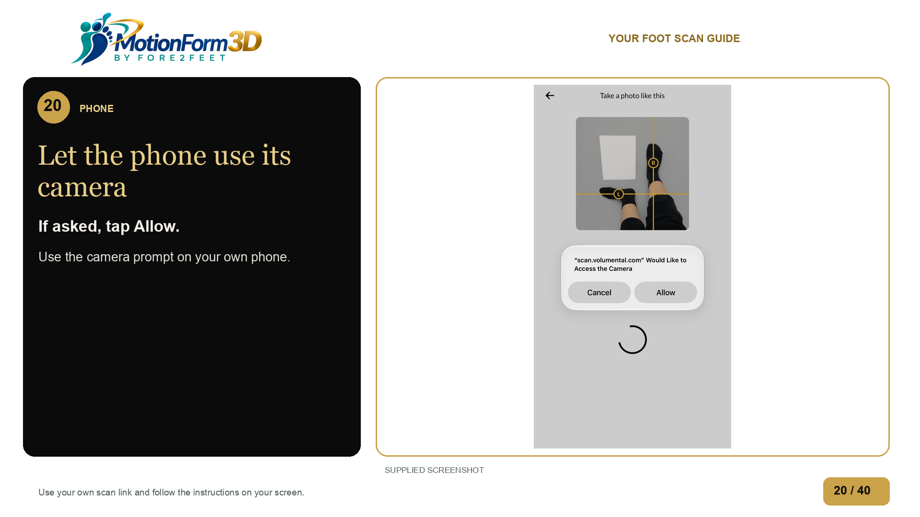
Notes:
If your phone asks for camera access, choose Allow.
Source: ../scan-camera-permission.jpg

Slide 21
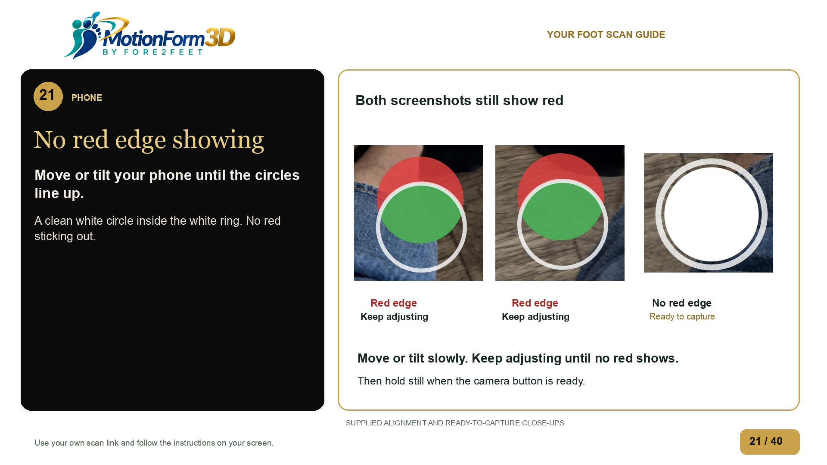
Notes:
Keep the whole paper and both feet in view. Both red-edge examples still need adjustment. Move or tilt your phone slowly until the circles line up. Keep adjusting while any red edge remains. The third screenshot shows the ready camera button: a clean white circle inside the outer white ring, with no red sticking out. Hold still, then take the photo when the button is ready.
Source: ../scan-align-view-a.jpg

Slide 22
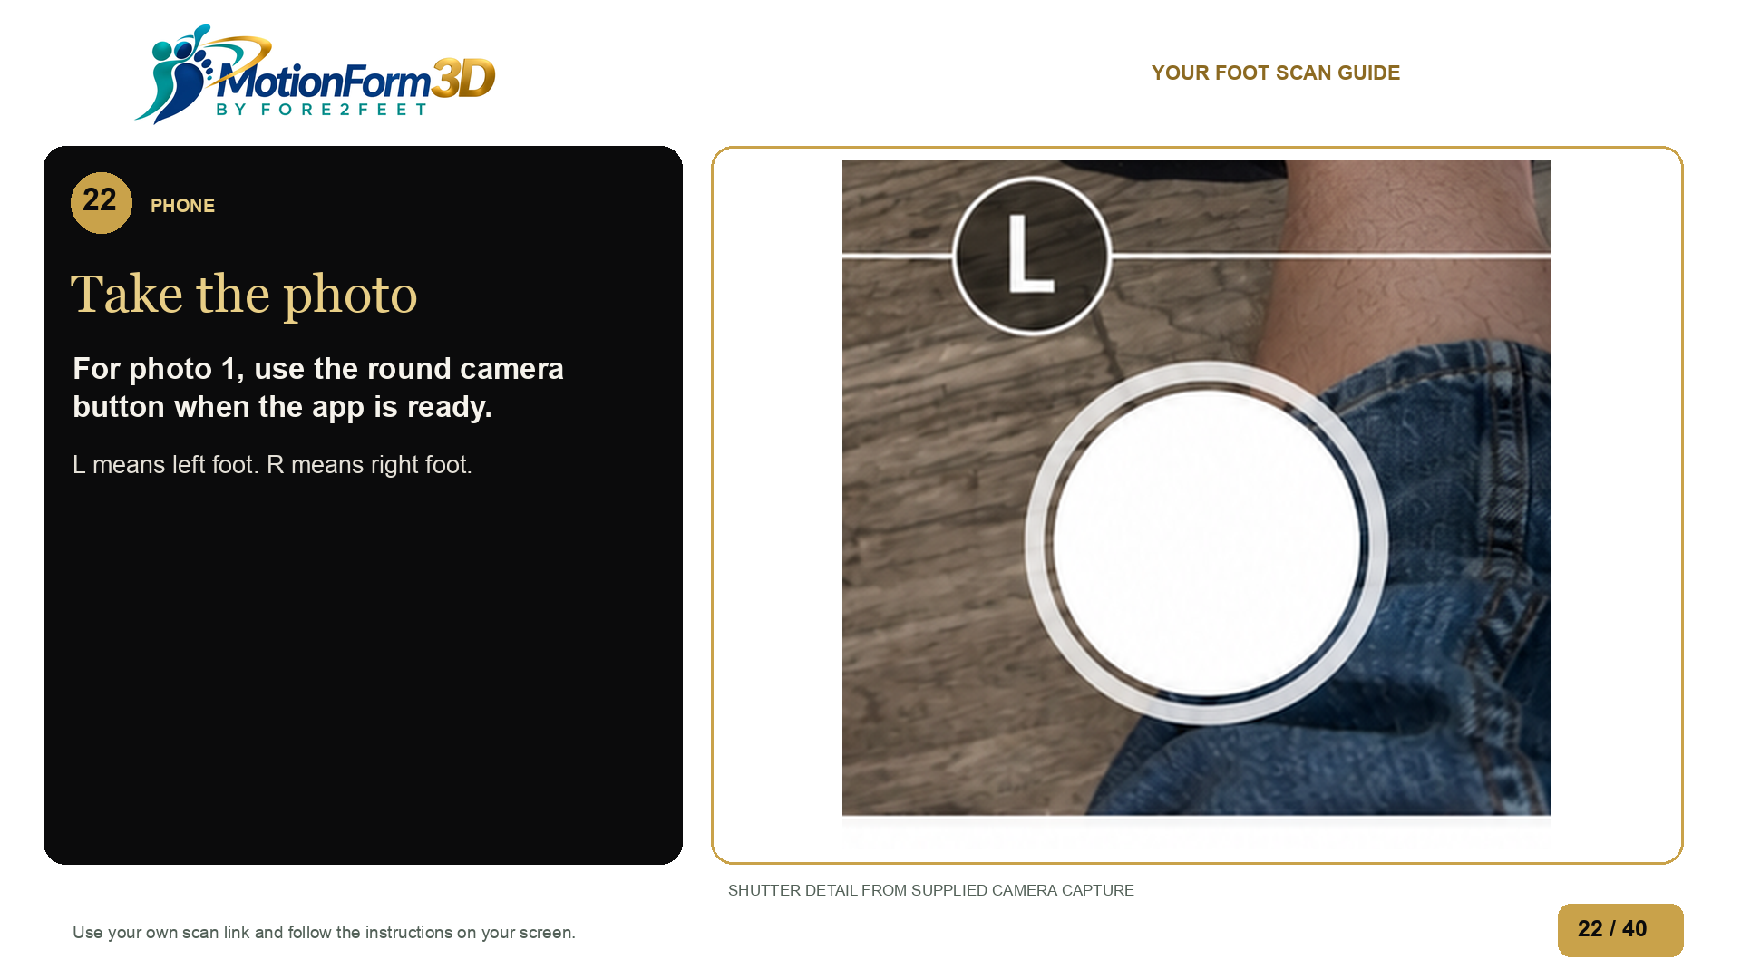
Notes:
When the circles line up and the camera button is ready, hold still and take the photo. Wait for the scanner's next instruction before moving your feet.
Source: edited-images/scan-photo-capture-edited.png
AI retouched photo. Original image retained.
Shutter control cropped from supplied camera capture, with the existing tattoo removal edit. The second pose is not presented as the first pose.

Slide 23
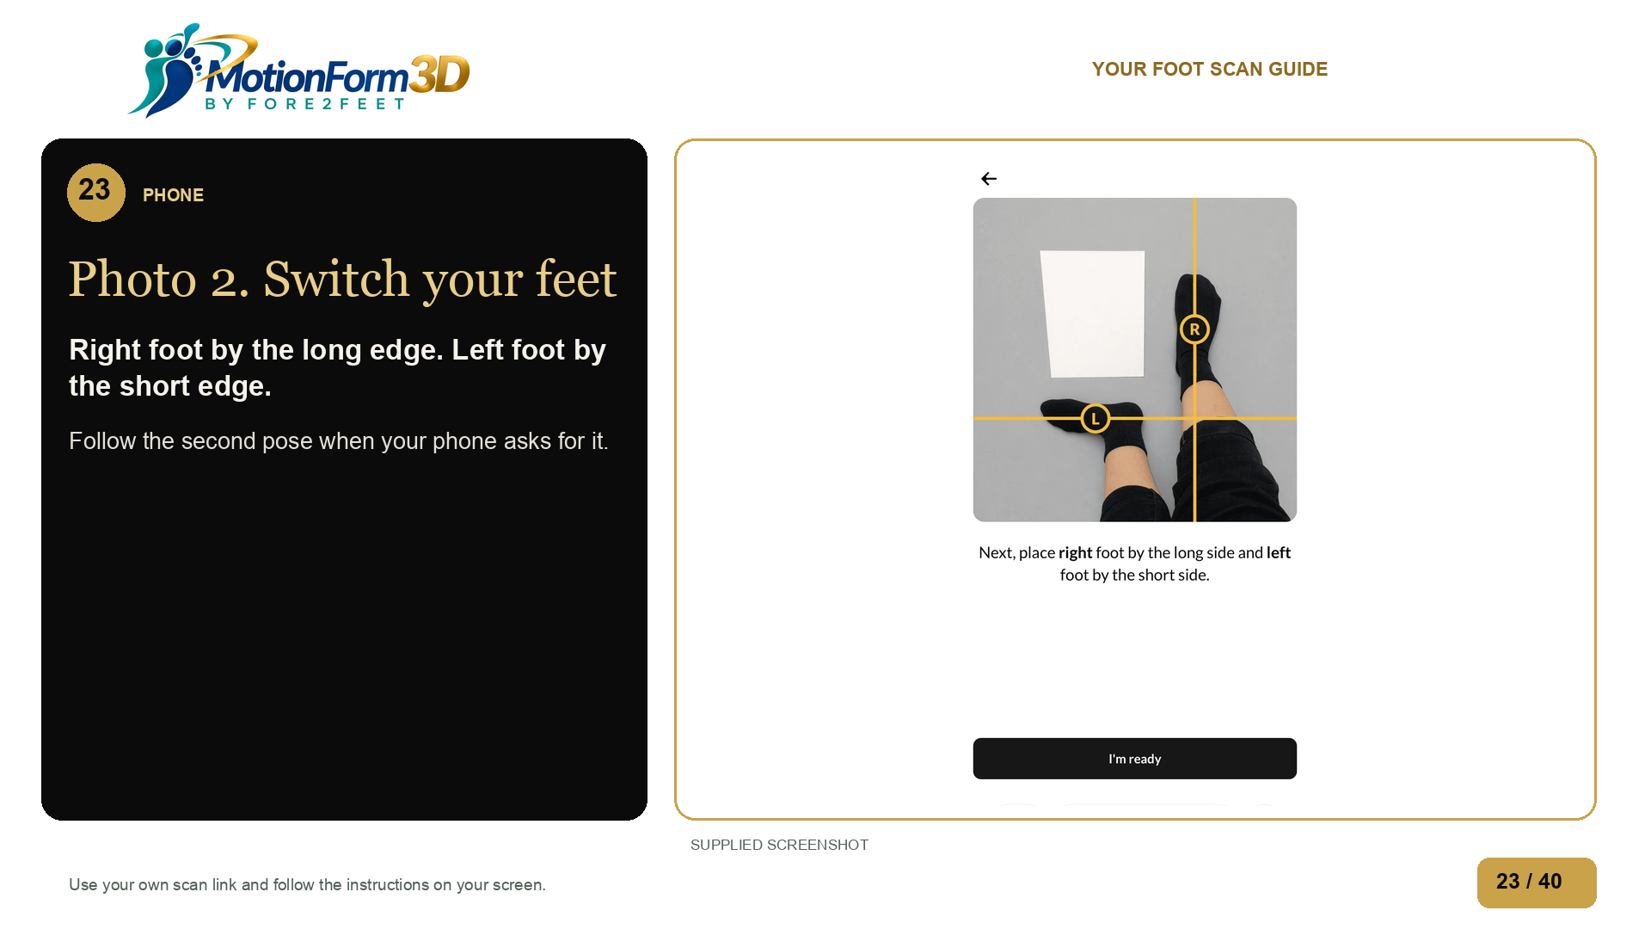
Notes:
When your phone asks for the second pose, put your right foot beside the long edge of the paper and your left foot beside the short edge. Match the picture on your phone, then tap I am ready.
Source: ../scan-foot-position-guide.jpg
Second pose from supplied phone capture. First photo acceptance and transition still need live proof.
The change from photo 1 to photo 2 has not yet been recorded.

Slide 24
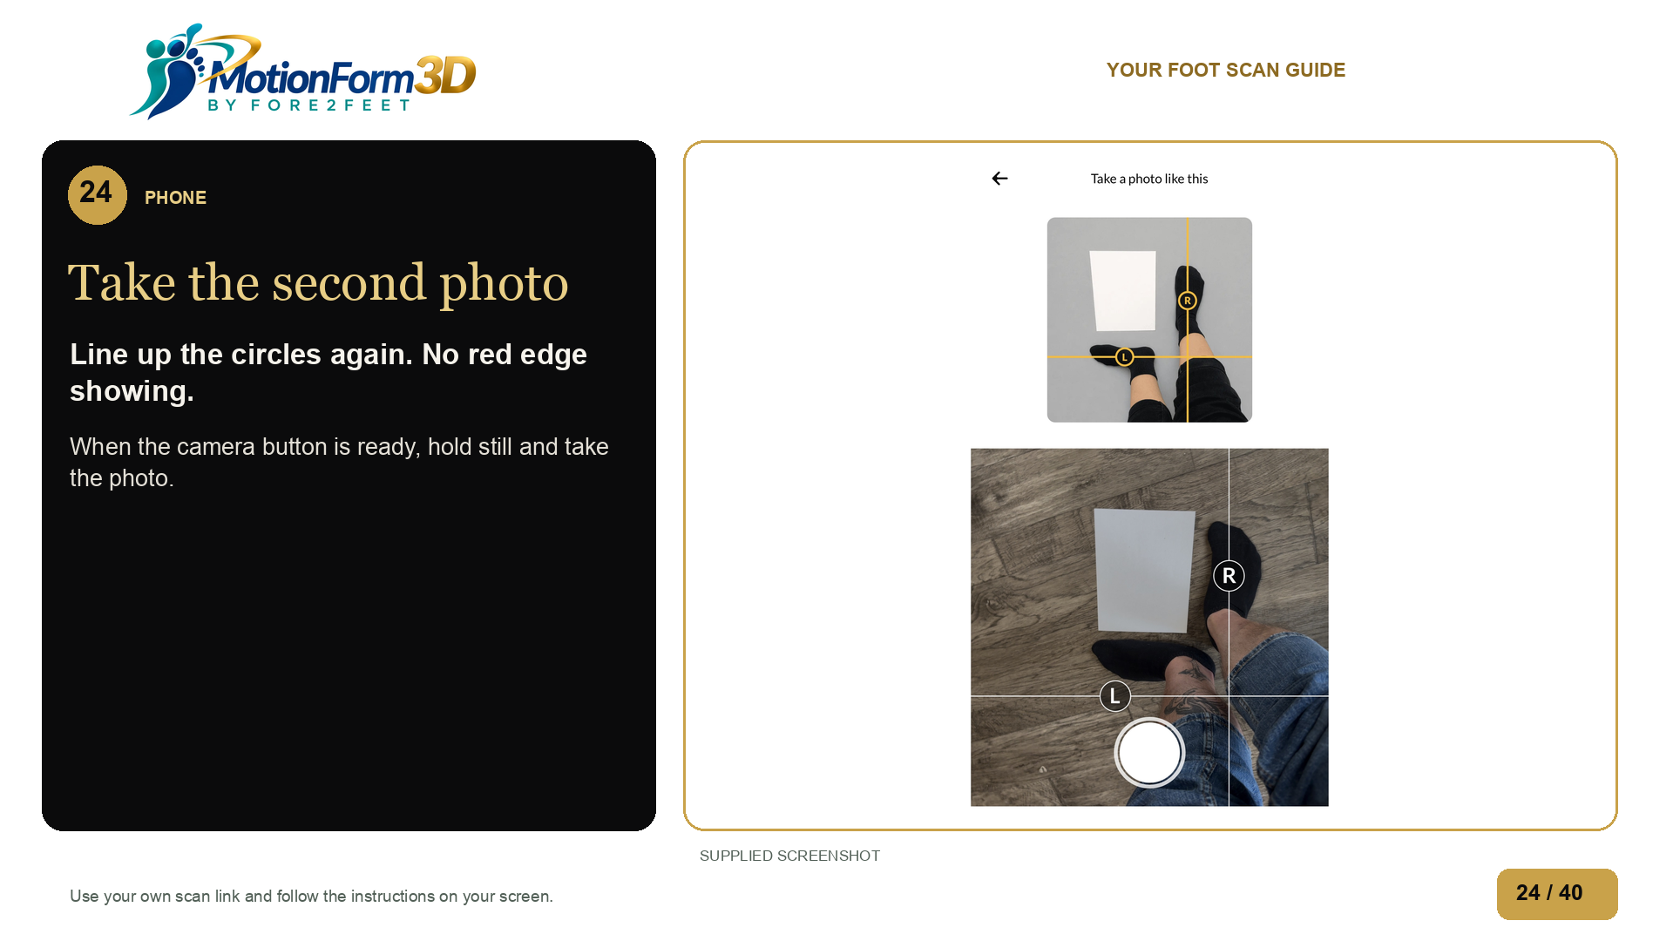
Notes:
Line up the circles again, with no red edge showing. Keep both feet and all four paper corners in view. When the camera button is ready, hold still and take the second photo.
Source: ../scan-photo-capture.jpg

Slide 25
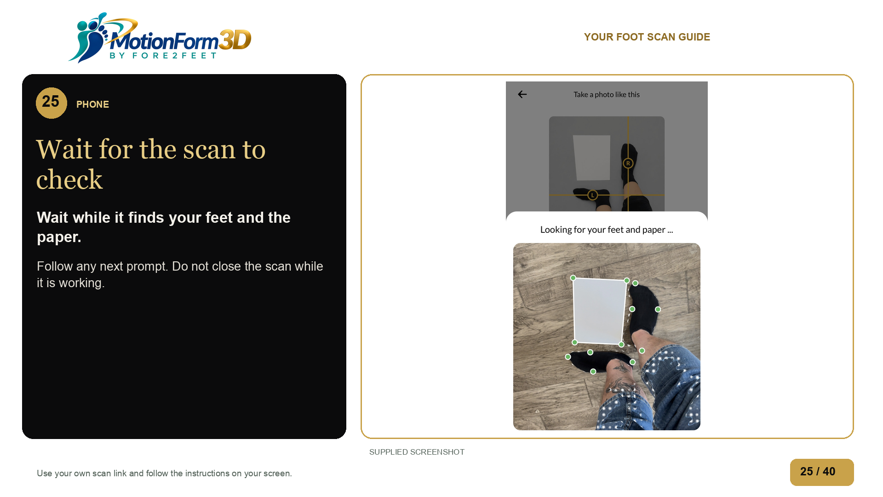
Notes:
Keep the scan open while it checks your photos. If it asks you to retake a photo, follow the prompt.
Source: ../scan-detect-feet-and-paper-b.jpg

Slide 26
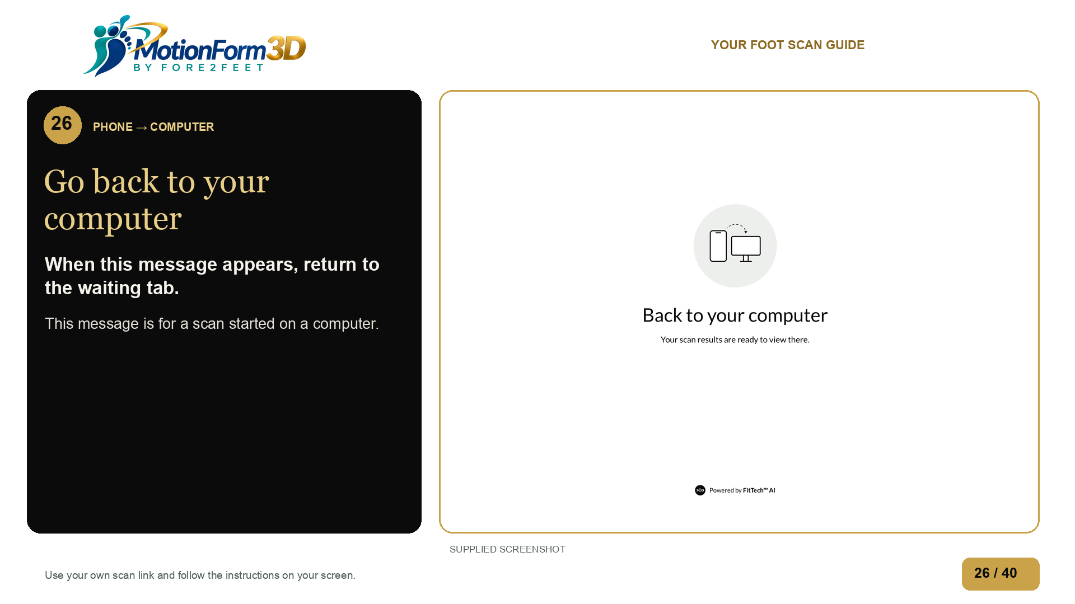
Notes:
If your phone says Back to your computer, return to the computer tab you left open. If you are using only your phone, follow the instructions on that phone.
Source: ../scan-results-return-to-computer.jpg

Slide 27
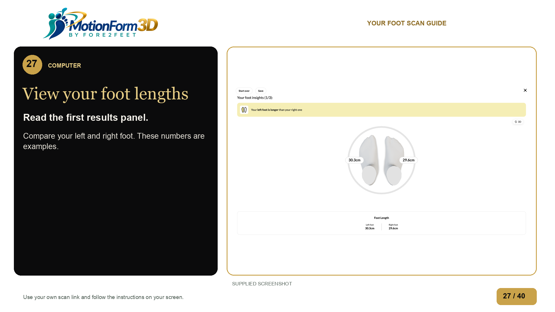
Notes:
The length panel shows a measurement for each foot. Compare your left and right foot. The numbers in this guide are examples. Read your own results.
Source: ../foot-insights-length.png
Exact controls between result panels need confirmation. Supplied captures show panels 1/3, 2/3 and 3/3 but no visible Next control.
The button or move for the next results panel still needs to be checked.

Slide 28
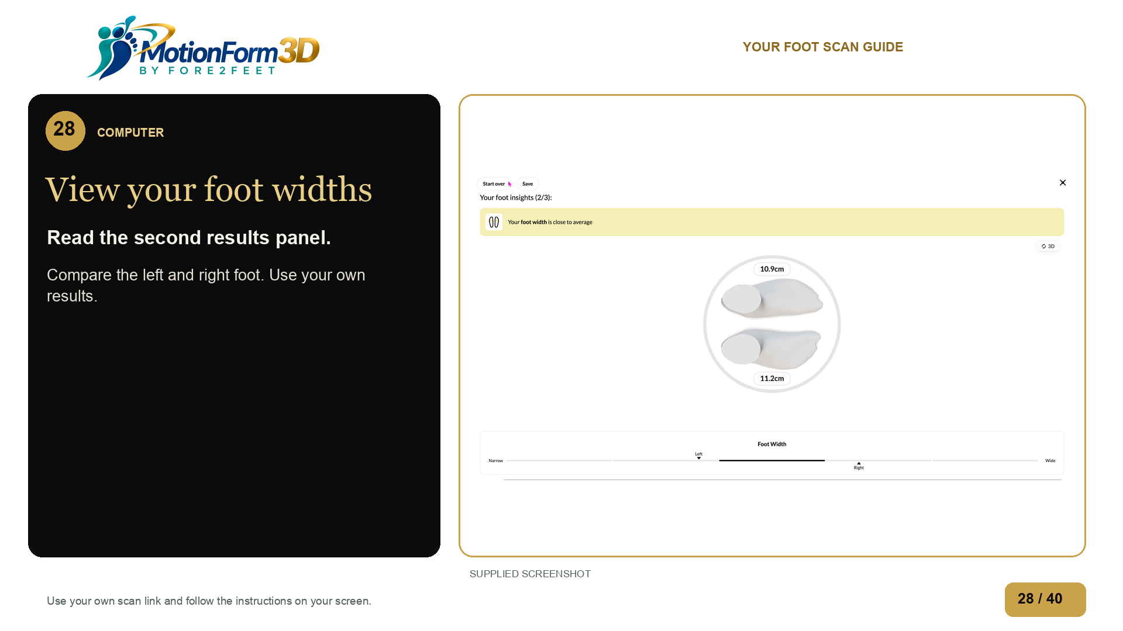
Notes:
The width panel compares the width of your left and right foot with the scale on the screen.
Source: ../foot-insights-width.png

Slide 29
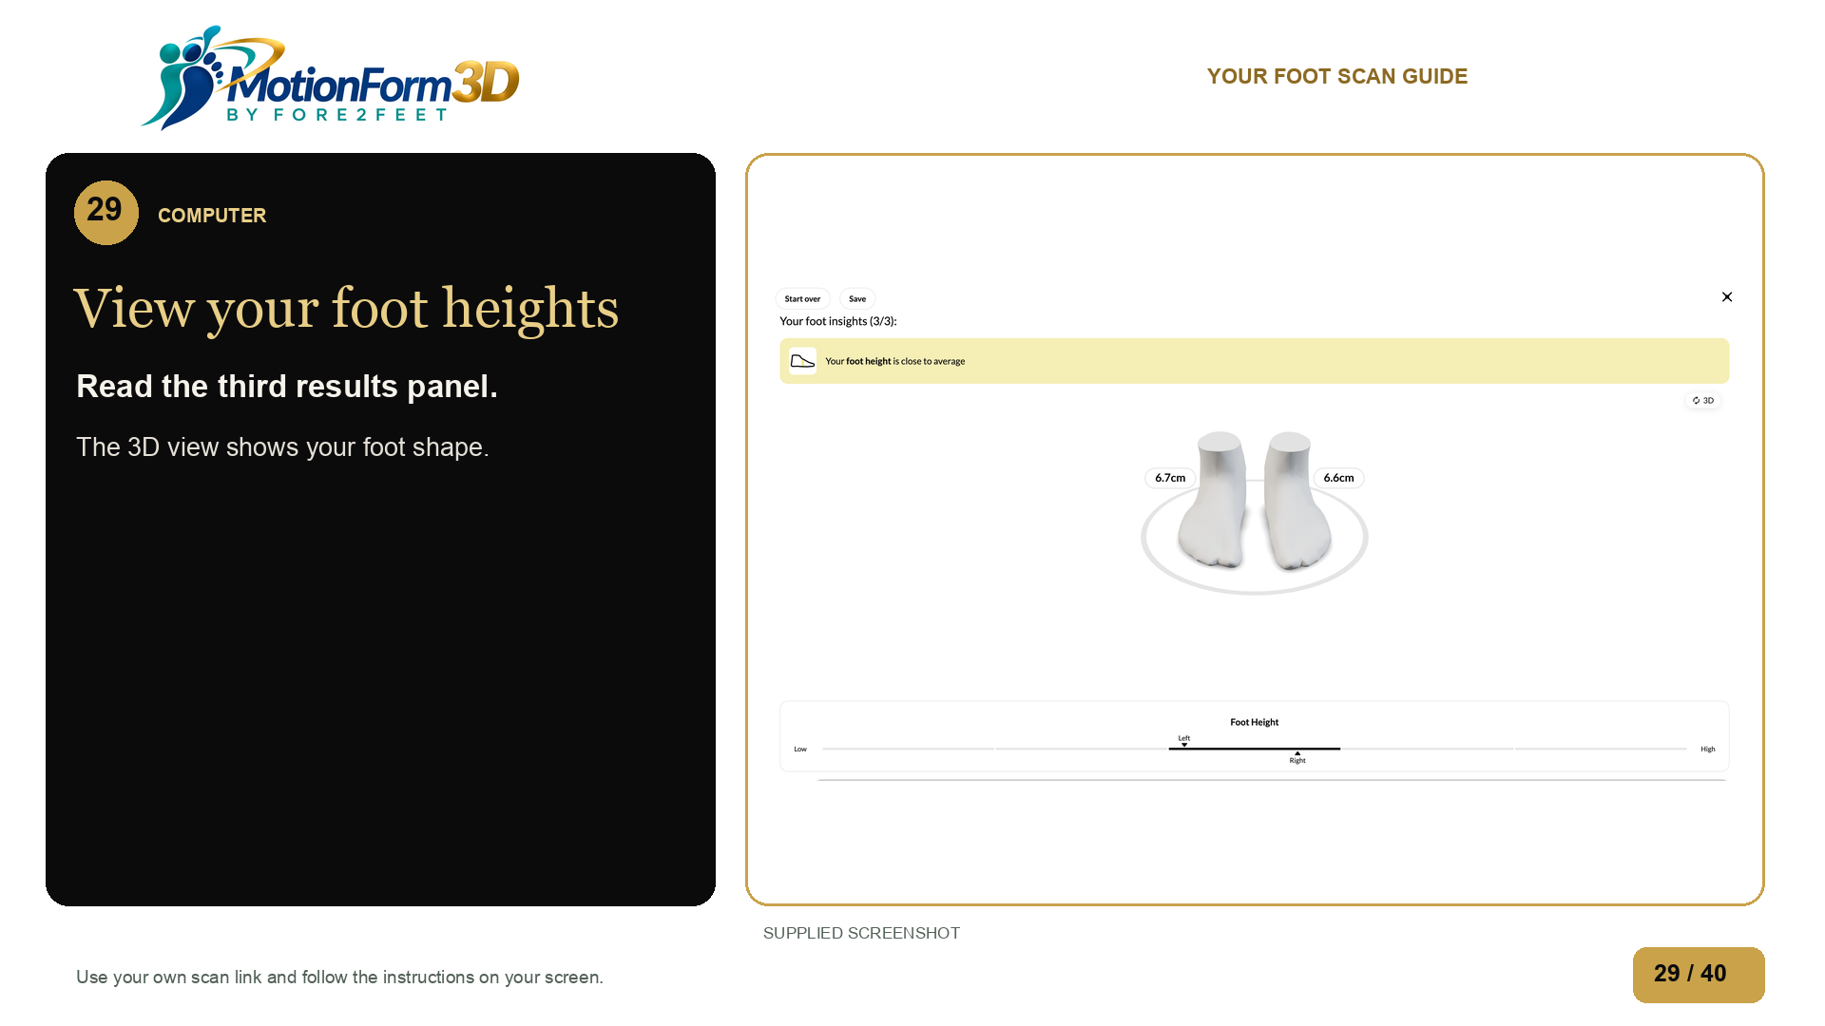
Notes:
The height panel shows foot height, and the 3D view shows your foot shape. These measurements are not medical advice. You can find saving and returning help in the slide guide.
Source: ../foot-insights-height.png

Slide 30
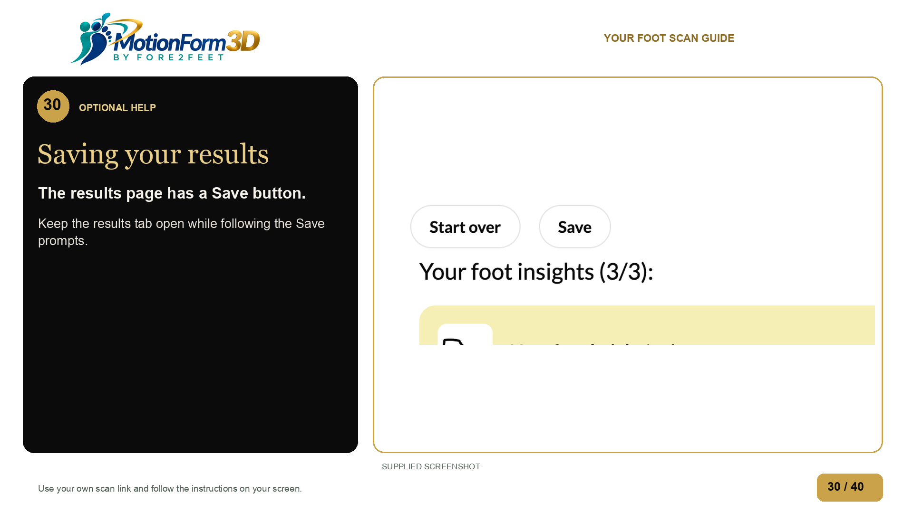
Notes:
The results page has a Save button. If you want to keep a copy of your results, follow the prompts shown there. Keep the tab open while you work through them.
Source: ../foot-insights-height.png
The steps after Save and reopening a saved scan have not been tested. This help slide does not promise autosave or recovery.

Slide 31
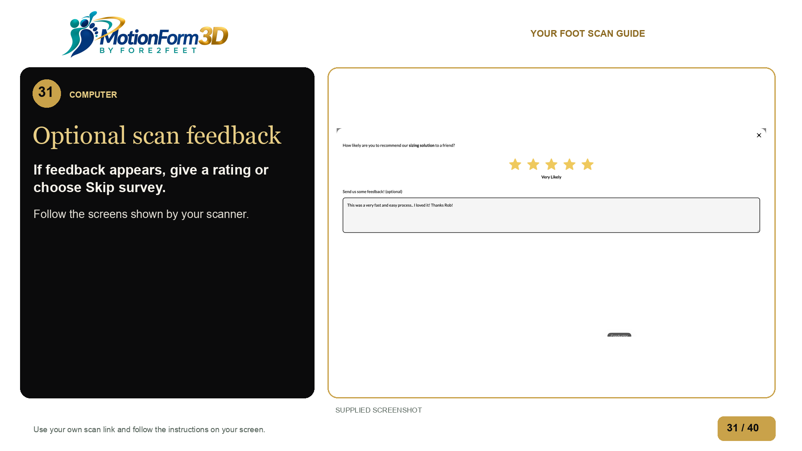
Notes:
You may see a feedback form when you leave the scanner. You can give a rating or choose Skip survey.
Source: ../sizing-feedback.png
Feedback was observed after exit without completing a scan. Correct exit timing and the completed scan callback need testing.

Slide 32
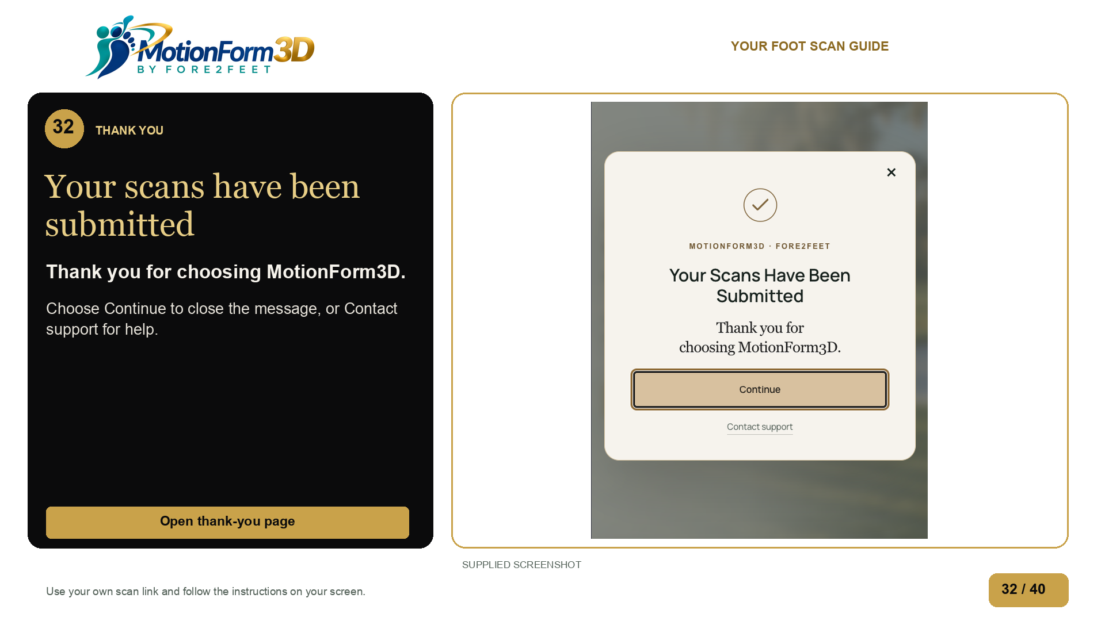
Notes:
The walkthrough ends at this thank you screen. Your Scans Have Been Submitted. Thank you for choosing MotionForm3D. Choose Continue to close this message. Contact support is there if you need help.
Source: edited-images/scan-thank-you-supplied.png
Andrew supplied this final screen and requested it as the ending. The scanner redirect is planned. This edited walkthrough does not prove a completed scan callback or receipt.

Slide 33
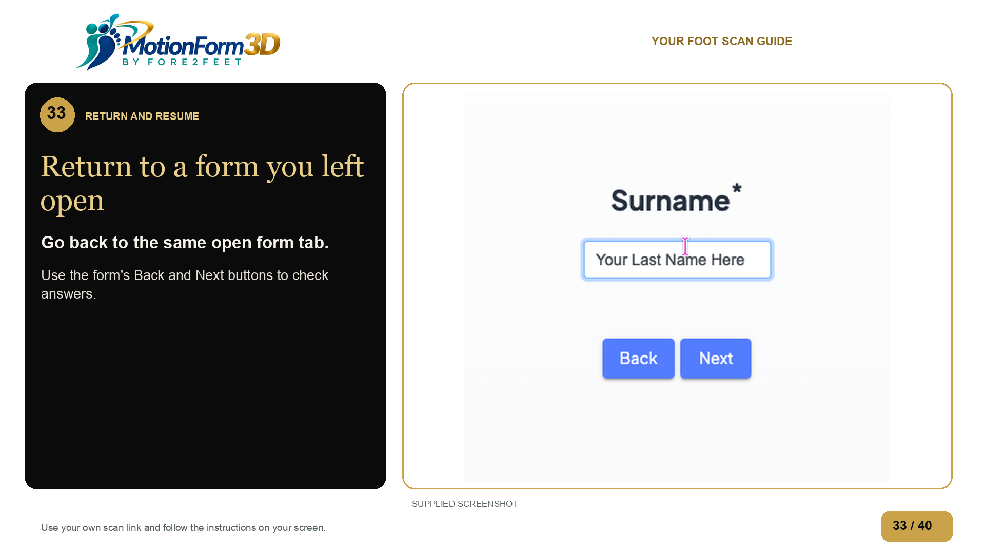
Notes:
Return to the same open form tab. Use Back and Next on the form to check your answers. A bookmark does not save your place at one question. If the form is blank, enter your answers again.
Source: ../questionnaire-surname.png

Slide 34
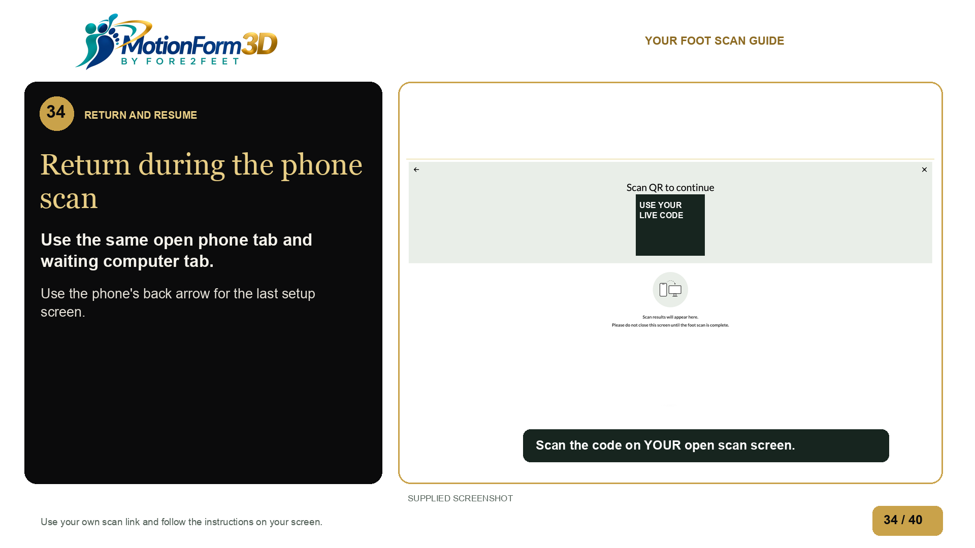
Notes:
Return to the same open phone scan tab. If you started on a computer, keep that waiting tab open too. Use the phone's back arrow to return to the last setup screen. Use your own session link, not someone else's code. If the scan has closed or expired, contact Fore2Feet for help.
Source: supplied-images/ScreenShot1014-2321-1792034501308-hz9zee.png

Slide 35
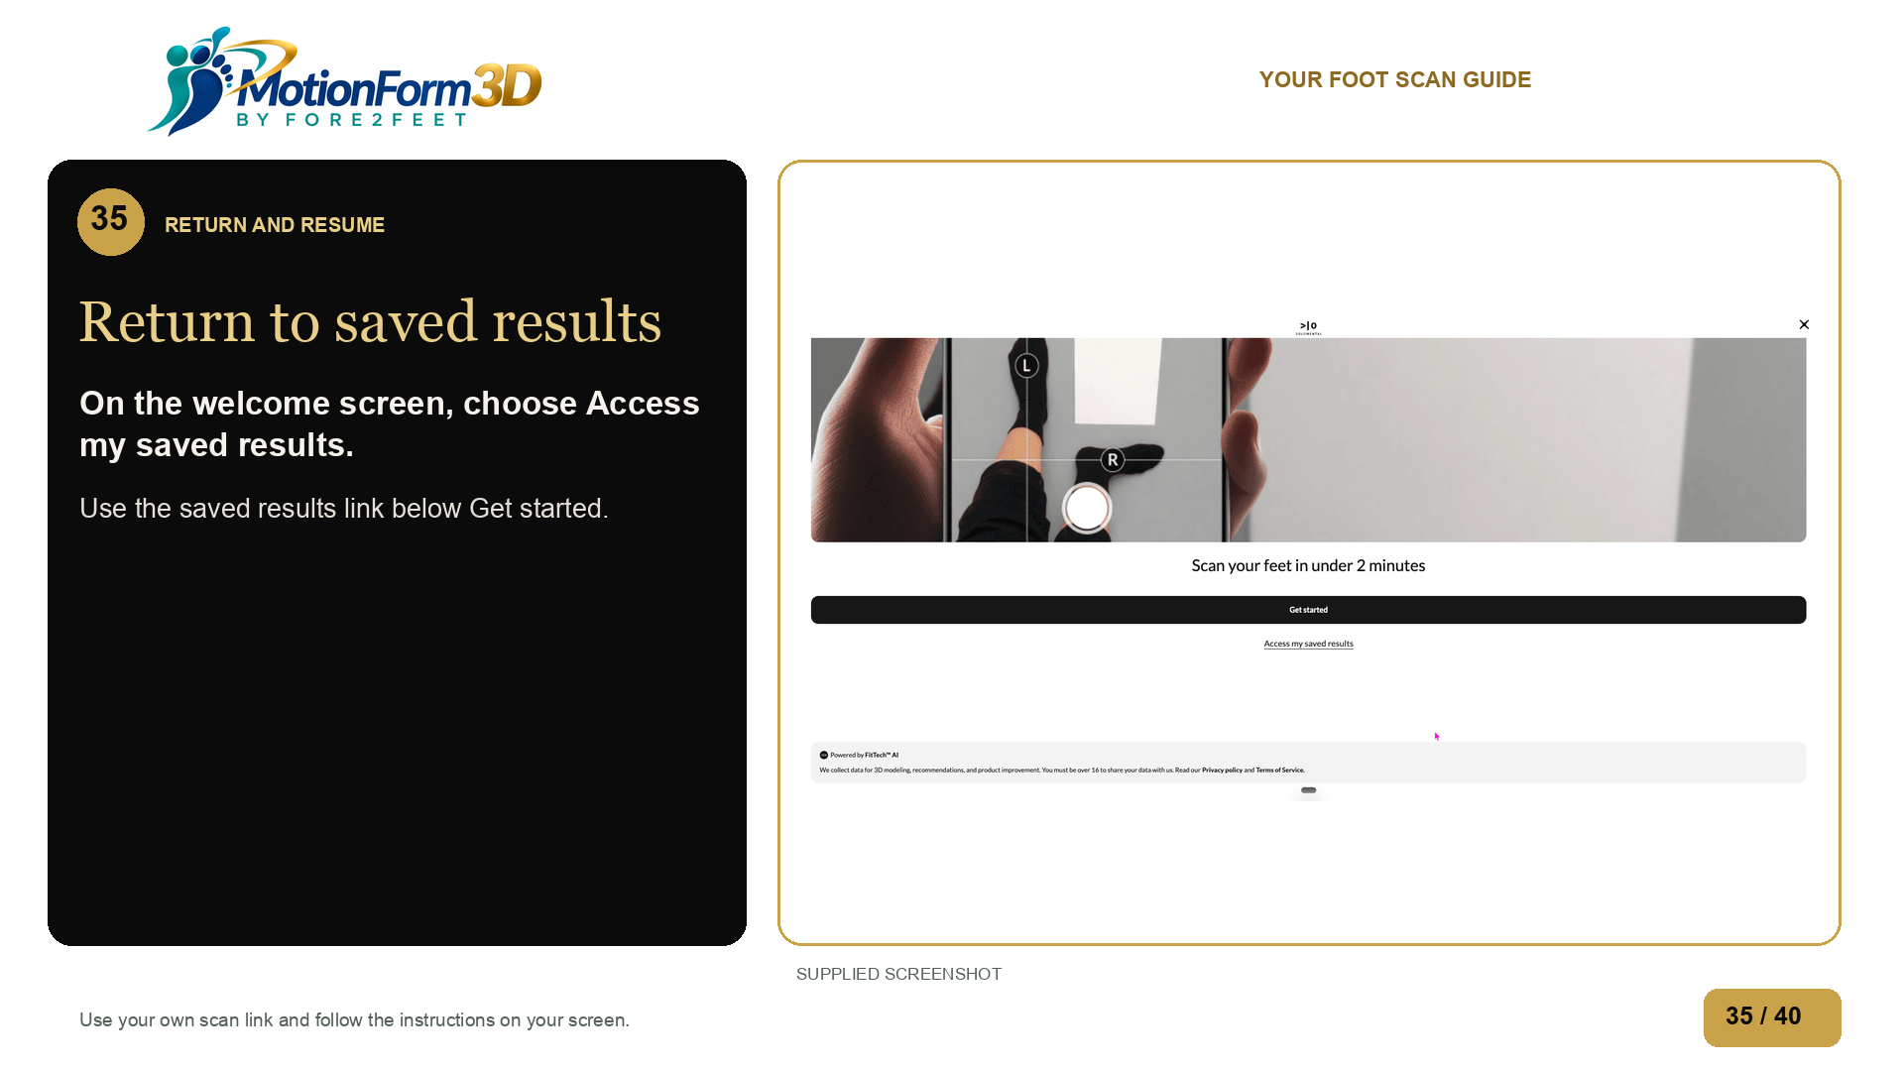
Notes:
On the scan welcome screen, choose Access my saved results below Get started.
Source: ../scan-introduction-get-started.png
Uses supplied scan introduction controls. Removed the unrelated browser login image. The supplied blue Wiky login remains excluded per Andrew’s direction.
The full saving and reopening sequence still needs a completed scan test.

Slide 36
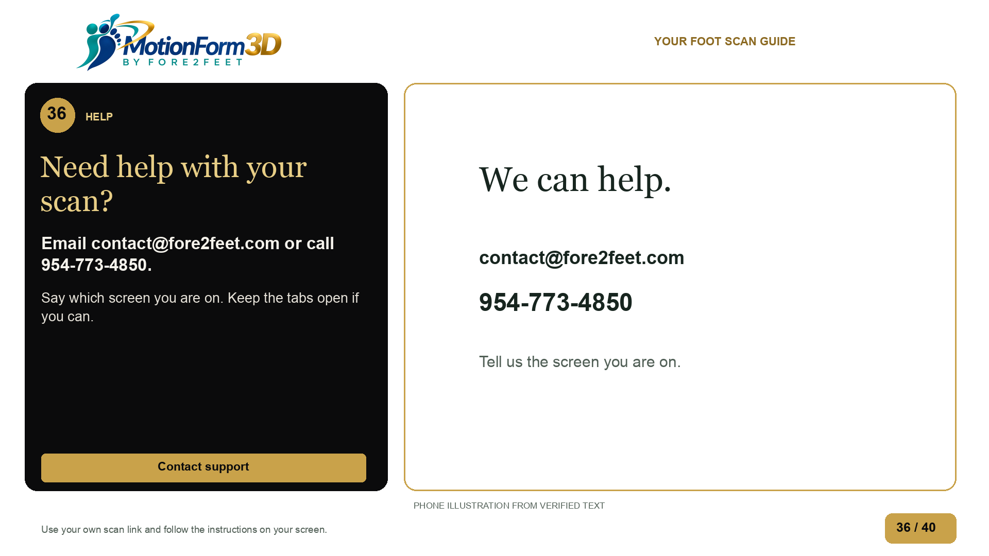
Notes:
If you get stuck, email contact at fore two feet dot com, or call nine five four, seven seven three, four eight five zero. Say which screen you are on and which pair you bought. Keep your tabs open if you can. Fore2Feet can help you find the right next step.
Source: Labeled illustration based on live browser text.

Slide 37
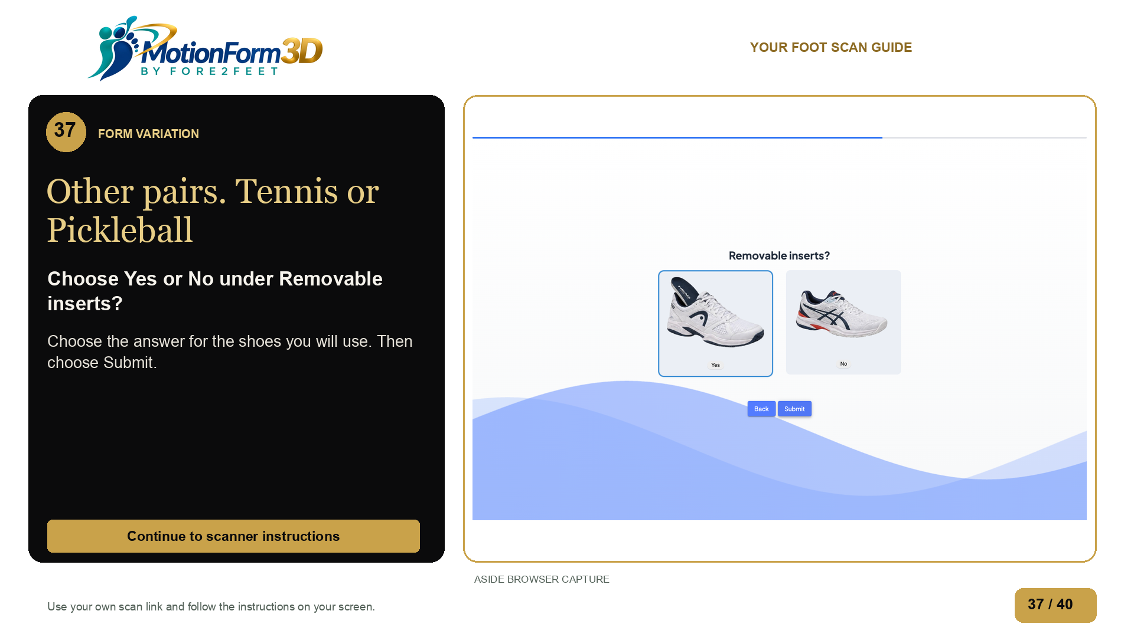
Notes:
For Tennis or Pickleball, choose Yes or No under Removable inserts, based on the shoes you will use. Then choose Submit and continue with the shared scanner instructions.
Source: browser-captures/product-routes/tennis-retained-inserts.png
Aside verified this route through its final question. Submit was not clicked on the non-Golf routes.

Slide 38
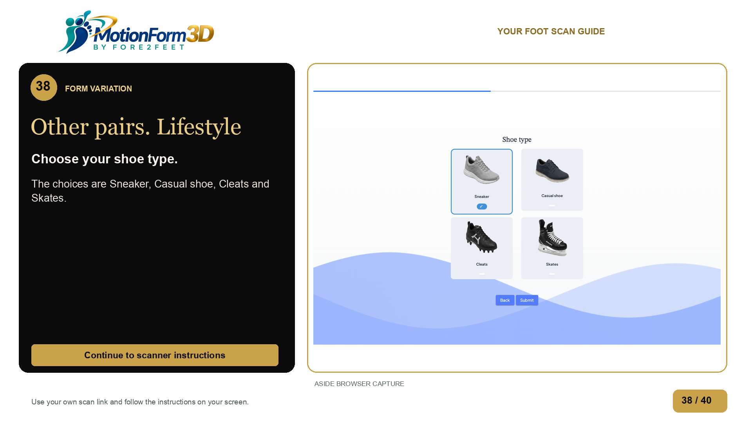
Notes:
For Lifestyle, choose the shoe types you will use. The options are Sneaker, Casual shoe, Cleats and Skates. You can select more than one. Choose Submit, then continue with the shared scanner instructions.
Source: browser-captures/product-routes/lifestyle-retained-shoe.png
Aside verified this route through its final question. Submit was not clicked on the non-Golf routes.

Slide 39
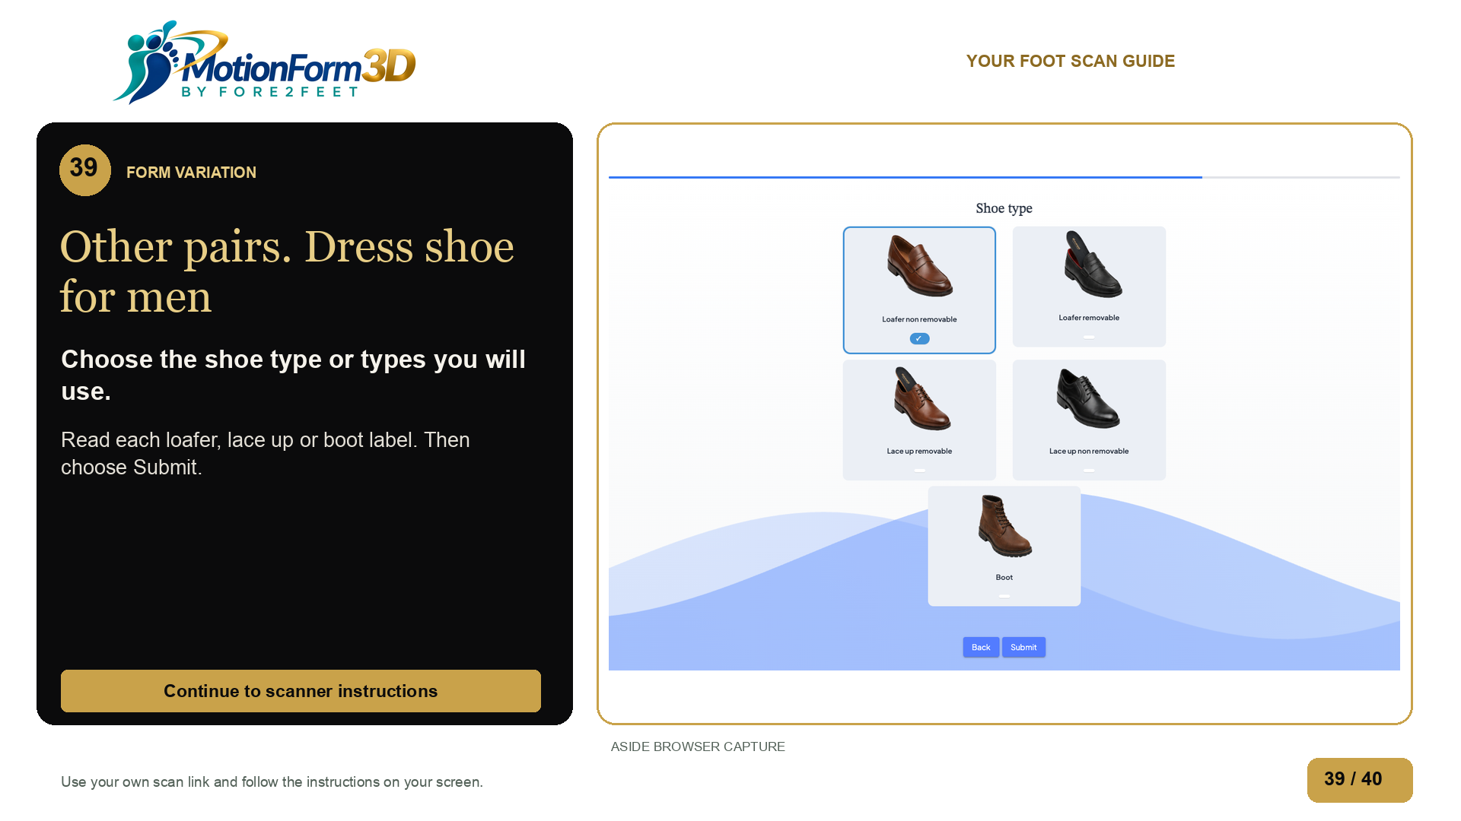
Notes:
For men's dress shoes, choose the types you will use. Read the loafer, lace up shoe and boot labels, including whether the inserts are removable or non removable. You can choose more than one. Choose Submit, then continue with the shared scanner instructions.
Source: browser-captures/product-routes/dress-men-07-final-unsubmitted.png
Aside verified this route through its final question. Submit was not clicked on the non-Golf routes.

Slide 40
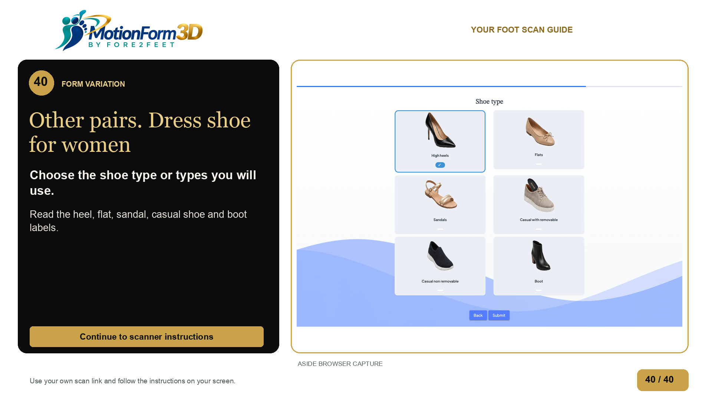
Notes:
For women's dress shoes, choose the types you will use. Read the high heel, flat, sandal, casual shoe and boot labels. Check whether the casual shoe option has removable or non removable inserts. You can choose more than one. Choose Submit, then continue with the shared scanner instructions.
Source: browser-captures/product-routes/dress-women-07-final-unsubmitted.png
Aside verified this route through its final question. Submit was not clicked on the non-Golf routes.

